Slide 1


Welcome to Mix2Win User Manual Version 1.0.10
Spectrophotometer Colour Matching
Part 1 – Installing a Spectro in Mix2Win Next
Part 2 – Colour Matching Collection Colours
  Finding the closest match to the colour sample from the available collections in the software
Part 3 – Colour Matching
  Calculating a new formula to match the colour sample

Slide 2
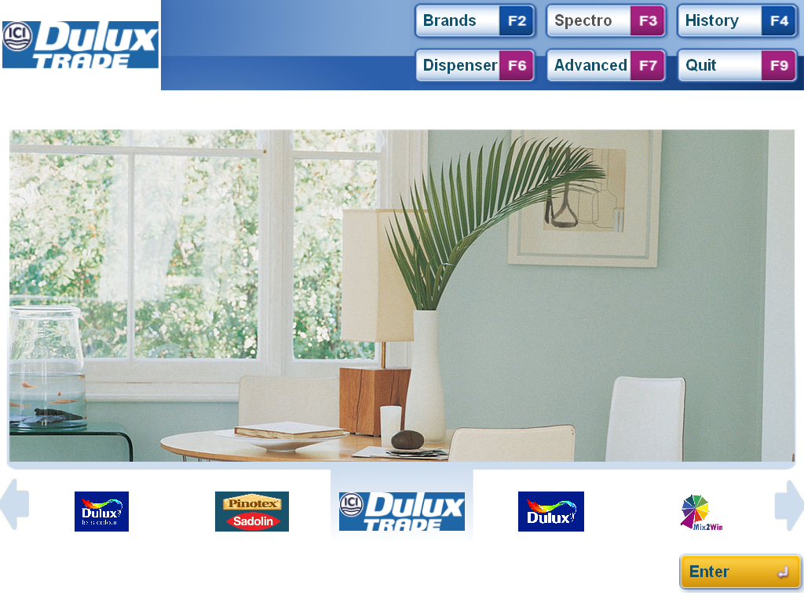
Part 1 – Installing a Spectrophotometer

Slide 3
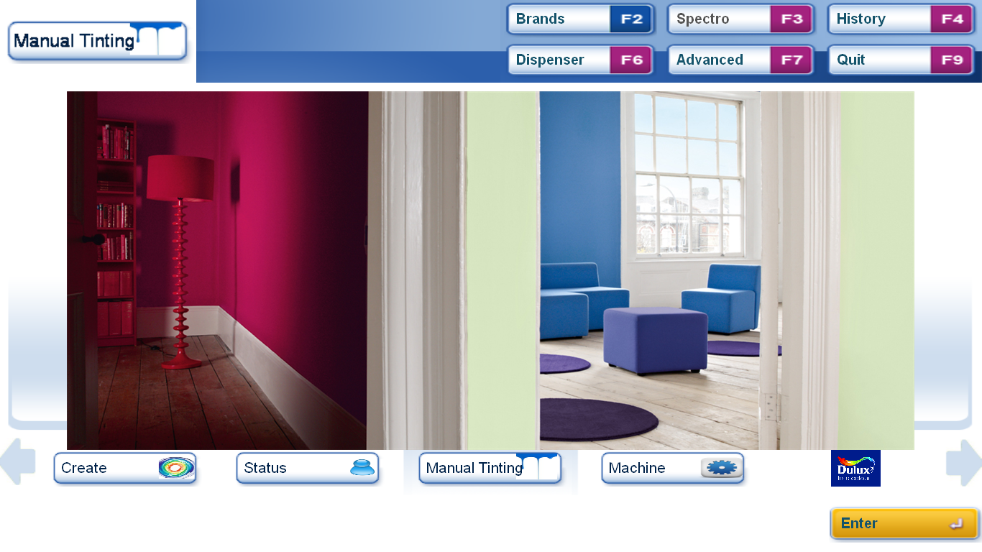
Installating a Spectrophotometer – Step 1
Advanced Button
From the start screen Click on Advanced or Press F7

Slide 4
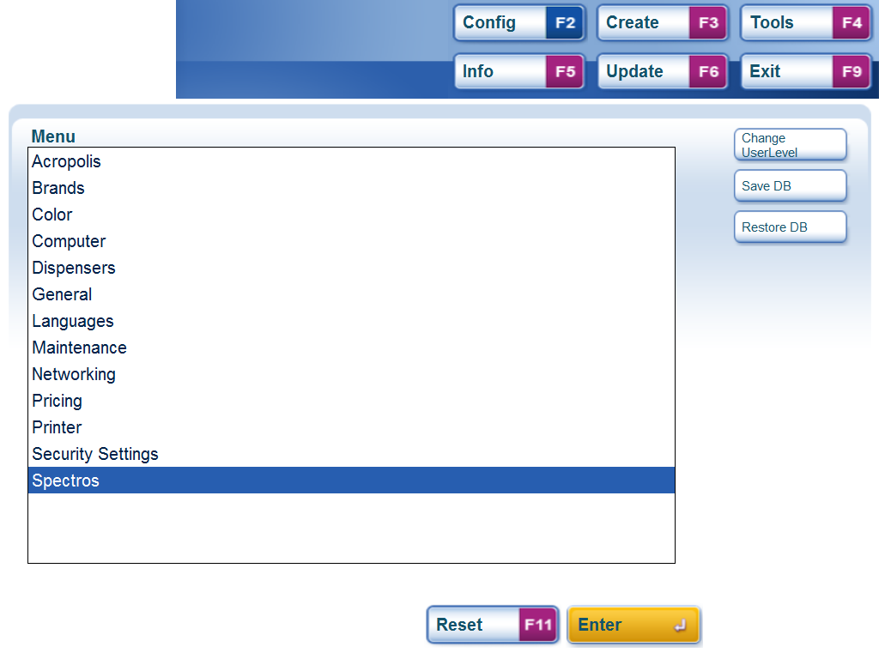
Installating a Spectrophotometer – Step 2
Advanced Menu
Spectro option is the last item on the list
Use the up and down arrows to scroll down the list to Spectros or select with the Mouse then press or Click Enter

Slide 5
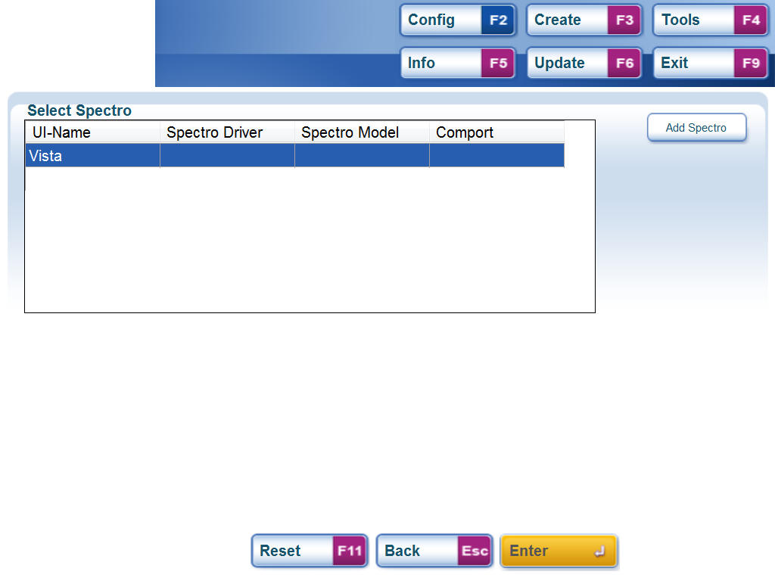
Installating a Spectrophotometer – Step 3
Add Spectro
PC Selection list
Select the PC on which to install the Spectro from the list (normally as here their will only be one choice).
With the target PC selected click the Add Spectro button or press ALT1

Slide 6
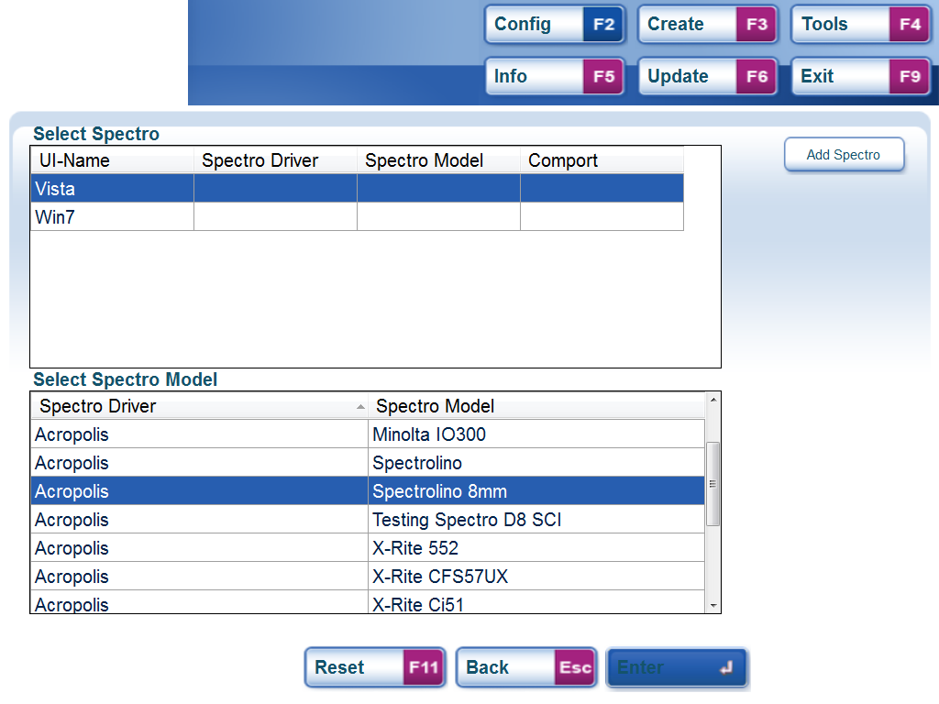
Installating a Spectrophotometer – Step 4
Spectro Selection List
A list of available Spectro’s is shown. Select the correct model from the list using the up and down arrow keys or the mouse cursor then press or click enter.

Slide 7
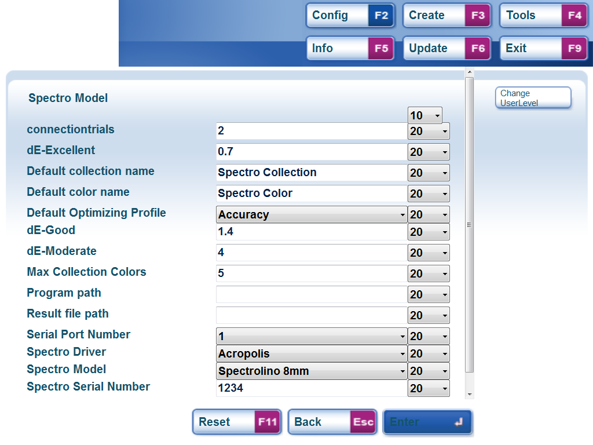
Installating a Spectrophotometer – Step 5
Spectro Configuration settings
Serial Port address
The Spectro settings are then shown, details will depend on your user level. Normally these should not need to be changed
Check that the Serial Port Number is correct and that the Spectro is connected. Then press or click enter to confirm.

Slide 8
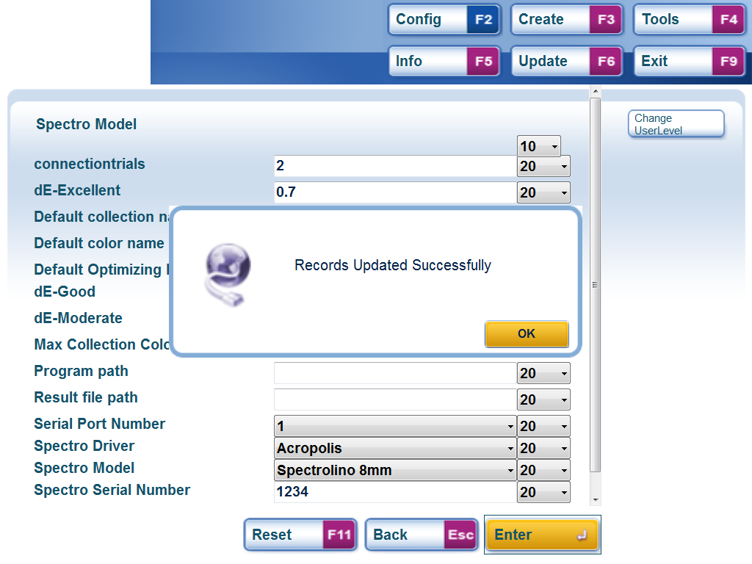
Installating a Spectrophotometer – Step 6
Spectro installation confirmation box.
The software attempts to communicate with the Spectro and the confirmation box means everything is connected and working.
Press OK to accept the message and then F9 to exit – the Spectro is now ready to use.

Slide 9
Part 2 – Colour Matching – Collection Colours

Slide 10
Collection Matching – Step 1
Spectro Button
From the start screen click on the Spectro button or Press F3 to start the Colour Matching process.
Note. If the button does not work the Spectro is not installed in Mix2Win Next or not switched on or not connected to the PC.

Slide 11
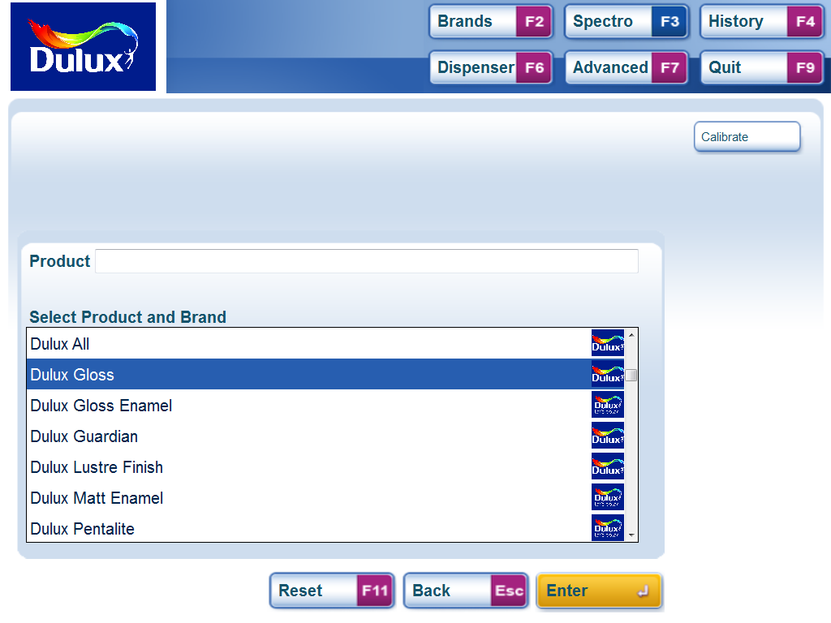
Collection Matching – Step 2
Brands
Products
The first screen shows the brands and products (shown together) that are available for colour matching.
Scroll up and down the list to highlight the product/brand wanted and press or click enter to select.

Slide 12
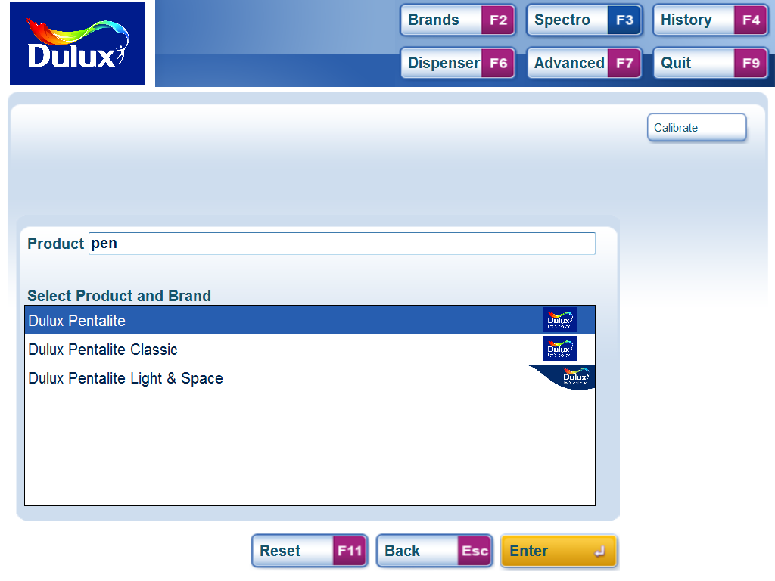
Collection Matching – Step 3
Refine the list by typing all or part of a Product Name
For long lists all or part of the Product name can be typed in the search box to refine the selection.
Highlight the desired choice and press or click enter to Select.

Slide 13
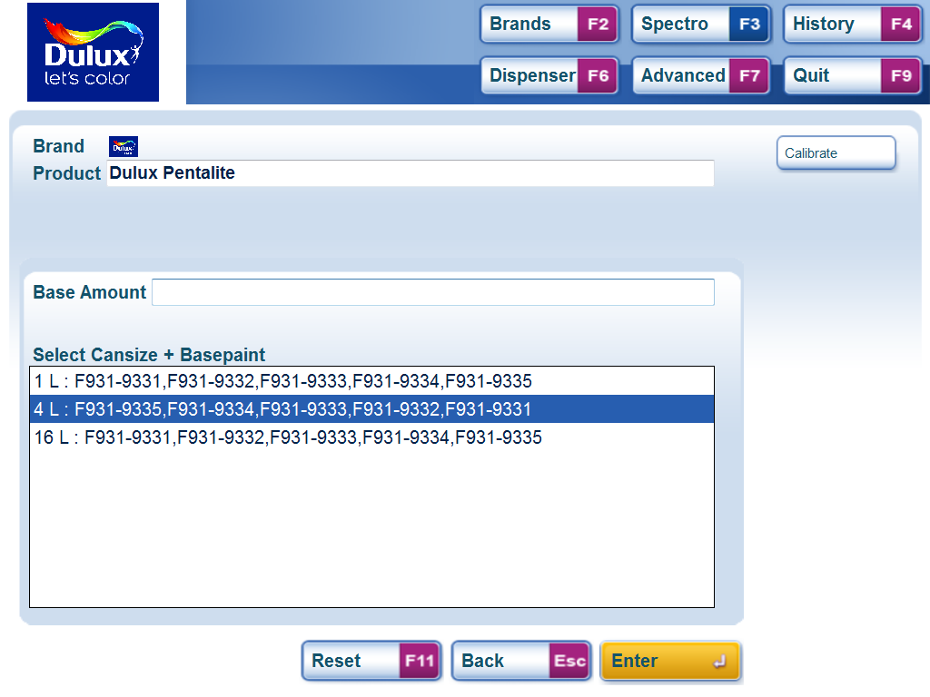
Collection Matching – Step 4
List showing can sizes and bases.
The list now shows the cansizes available and all the bases available in that cansize. Select the Can Size and base combination that you want by scrolling or clicking to highlight the desired choice. Then press or click enter to Select.

Slide 14
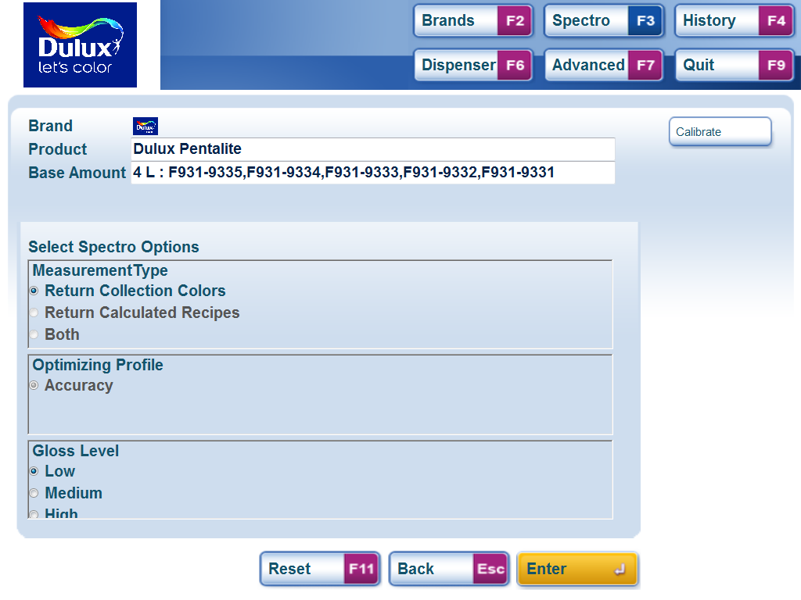
Collection Matching – Step 5
Measurement type.
Gloss Level
Now select the measurement type and gloss level. For collection matching select “Return Collection Colours”. In some cases this maybe the only choice.
Set the gloss level of the sample then press or click enter to confirm.

Slide 15
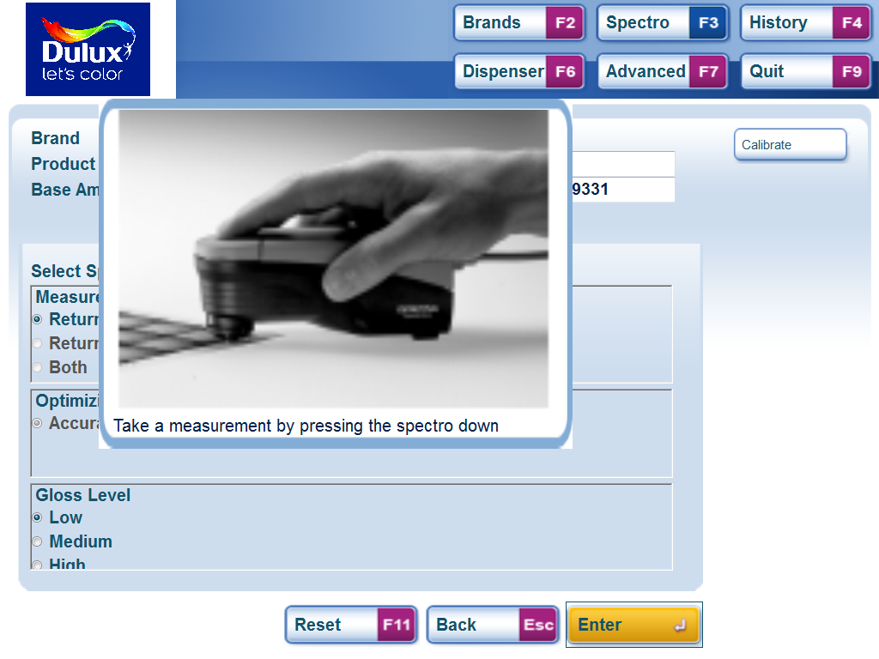
Collection Matching – Step 6
Spectro specific pictures and instructions
Follow the onscreen pop-up instructions to measure the sample.
The pictures and exact instructions will vary between instruments. When the sample has been successfully measured the software will then present the results.- this may take a few seconds..

Slide 16
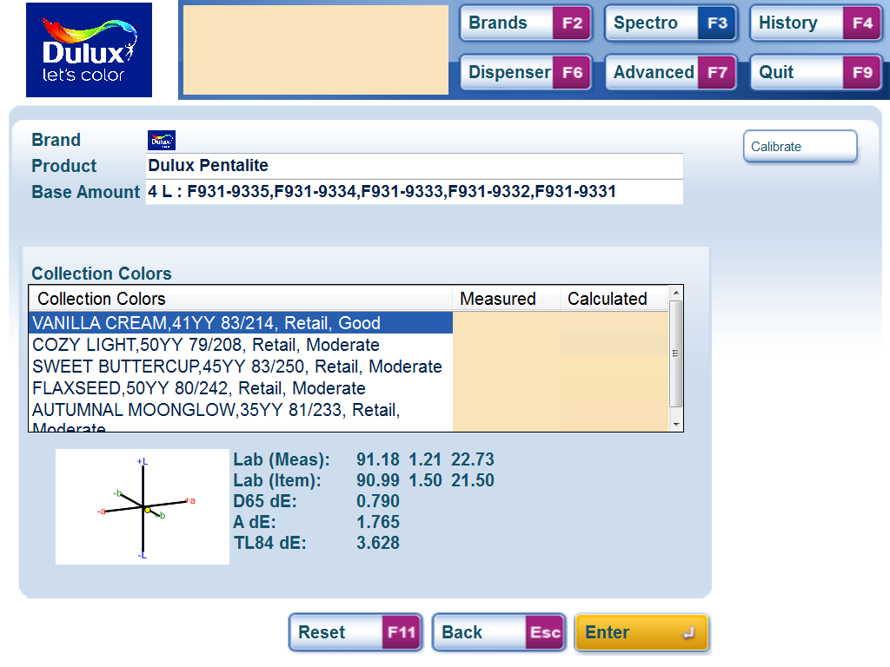
Collection Matching – Step 7
Results with colour indication
Detailed information
Normally up to 5 results will be shown in order of accuracy to the sample. Scroll down the list to see the detailed information
Highlight the preferred result and press or click enter to proceed.

Slide 17
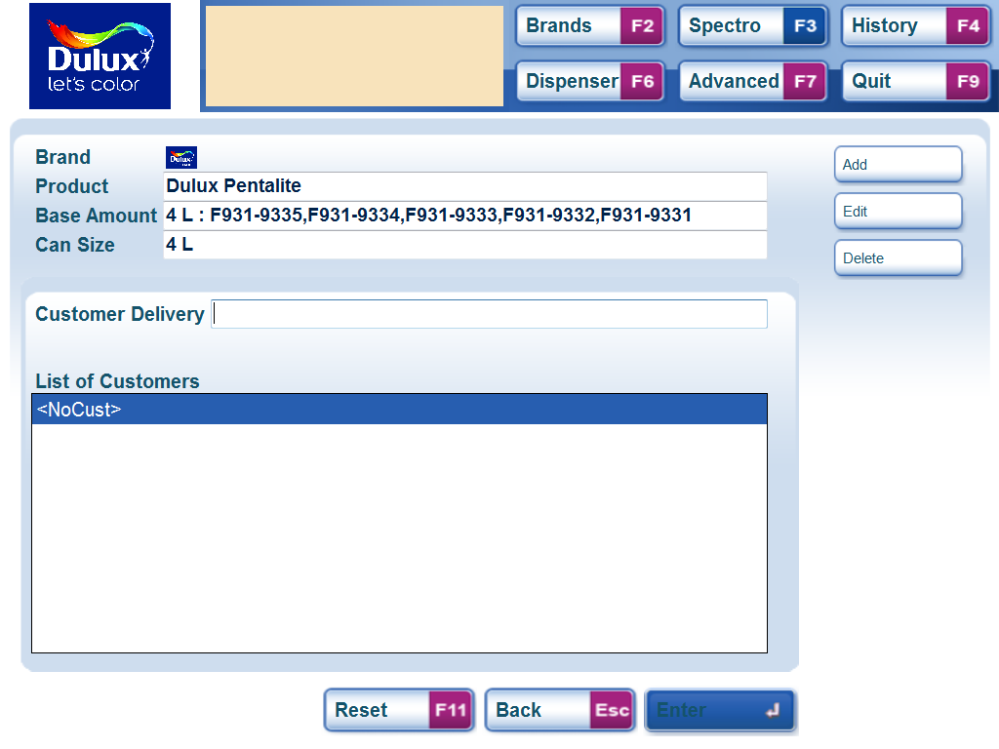
Collection Matching – Step 8
Add Customer
Customer List
If you want to save a customer name with the colour either select a customer from the list or add a new one by clicking add or pressing ALT1
To proceed Click or Press Enter.

Slide 18
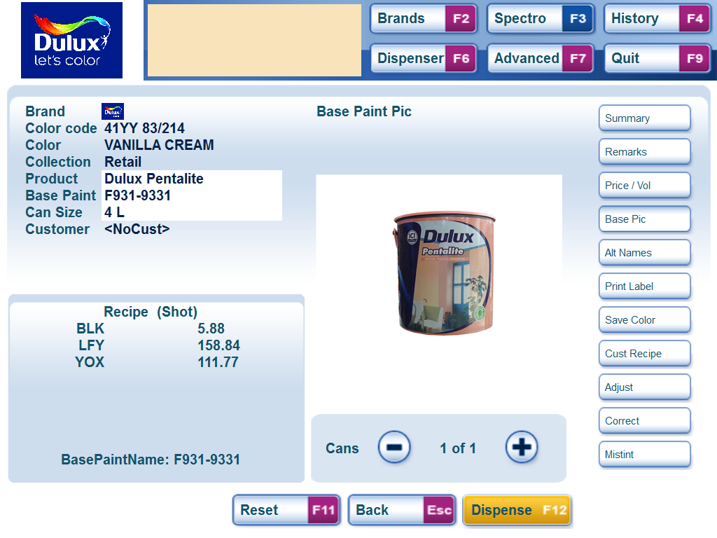
Collection Matching – Step 9
Details
Summary of Details
Formula
This screen shows a summary of the selections made. For other details click on the buttons on the right.
To Dispense click the Button or Press F12
To start again press F11 to return to the start screen.

Slide 19
Part 3 – Full Colour Matching

Slide 20
Colour Matching – Step 1
Spectro Button
From the start screen click on the Spectro button or Press F3 to start the Colour Matching process.
Note. If the button does not work the Spectro is not installed in Mix2Win Next or not switched on or not connected to the PC.

Slide 21
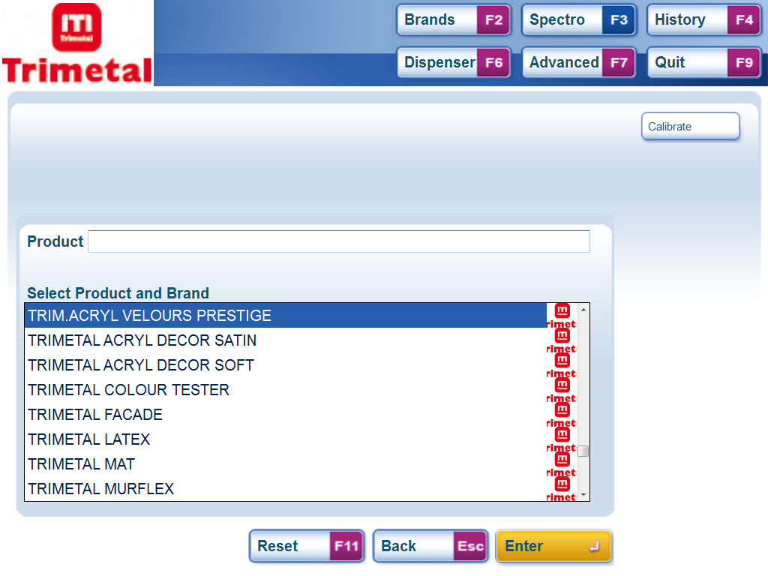
Colour Matching – Step 2
Brands
Products
The first screen shows the brands and products (shown together) that are available for colour matching.
Scroll up and down the list to highlight the product/brand wanted and press or click enter to select.

Slide 22
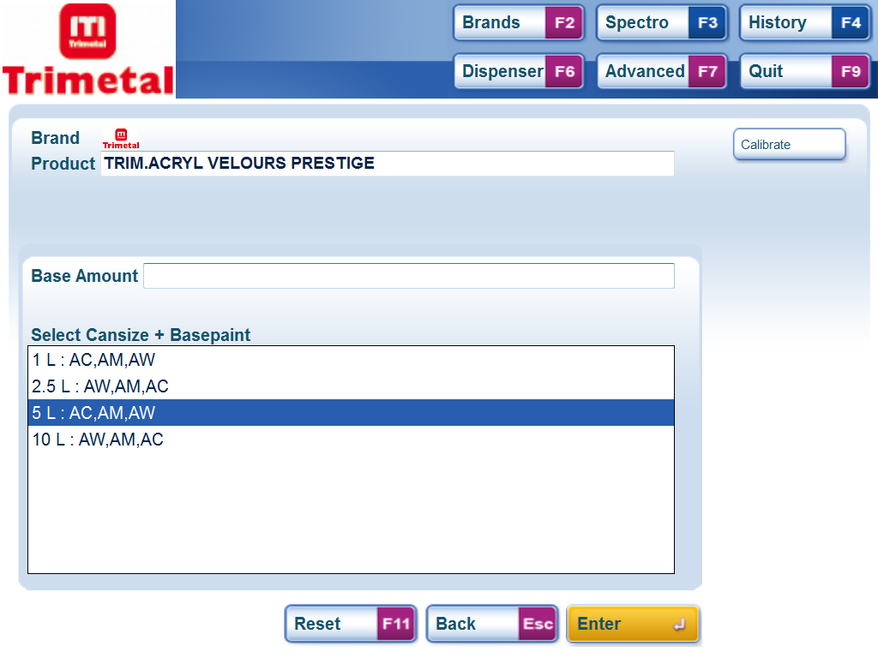
Colour Matching – Step 3
List showing can sizes and bases.
The list now shows the cansizes available and all the bases available in that cansize. Select the Can Size and base combination that you want by scrolling or clicking to highlight the desired choice. Then press or click enter to Select.

Slide 23
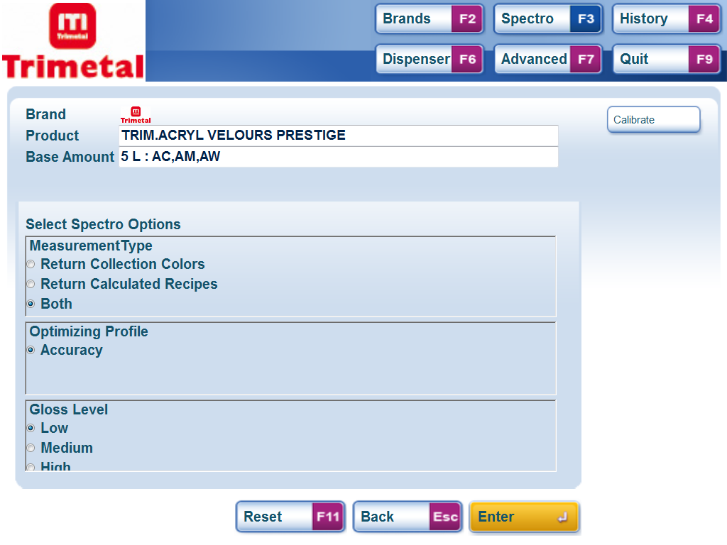
Colour Matching – Step 4
Measurement type.
Gloss Level
Now select the measurement type and gloss level. For full colour matching select either “Both” or “Return Calculated Recipes”. Note for some products these choices may not be available.
Set the gloss level of the sample then press or click enter to confirm.

Slide 24
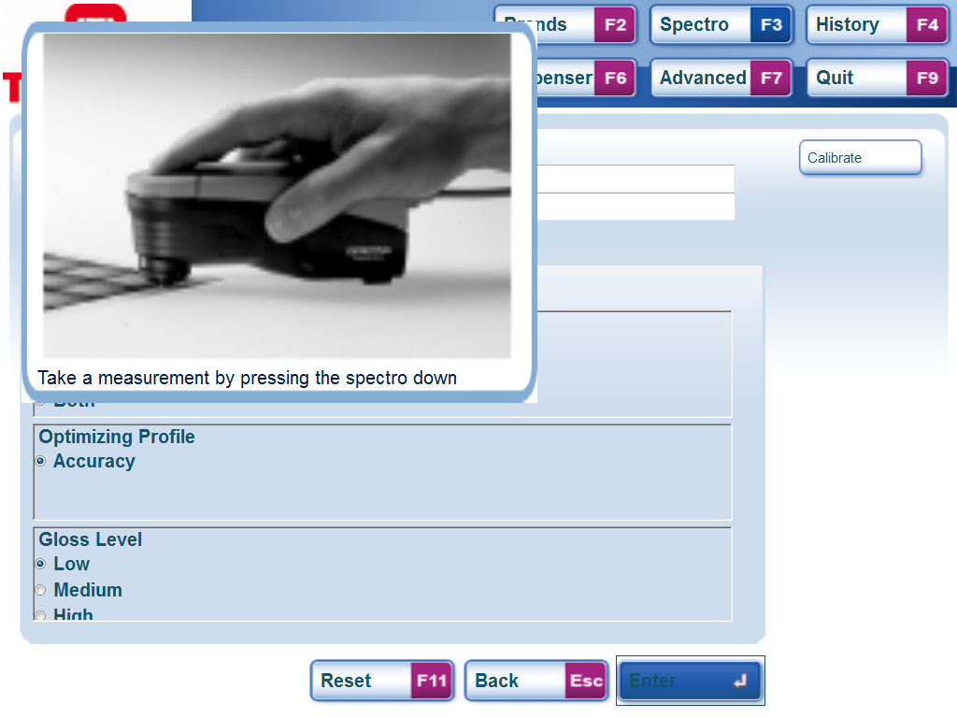
Colour Matching – Step 5
Spectro specific pictures and instructions
Follow the onscreen pop-up instructions to measure the sample.
The pictures and exact instructions will vary between instruments. When the sample has been successfully measured the software will then present the results.- this may take a few seconds..

Slide 25
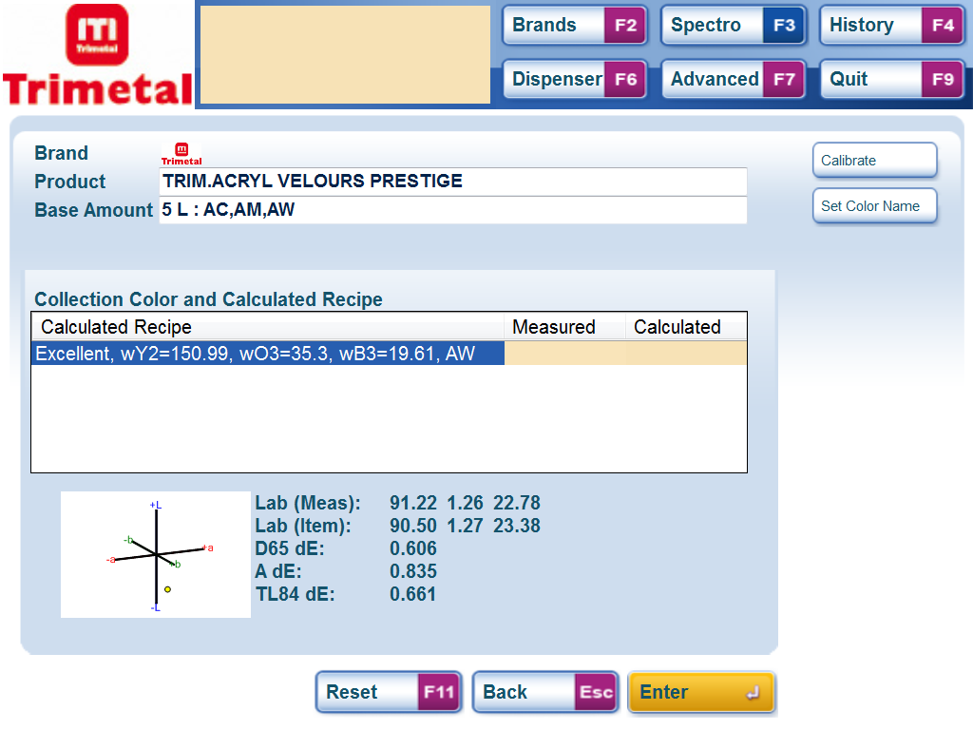
Colour Matching – Step 6
Results with colour indication
Detailed information
Typically 1 result will be shown along with a comment on the predicted accuracy of the result, the formula and Base and a visual indication of the colour.
Press or click enter to proceed.

Slide 26
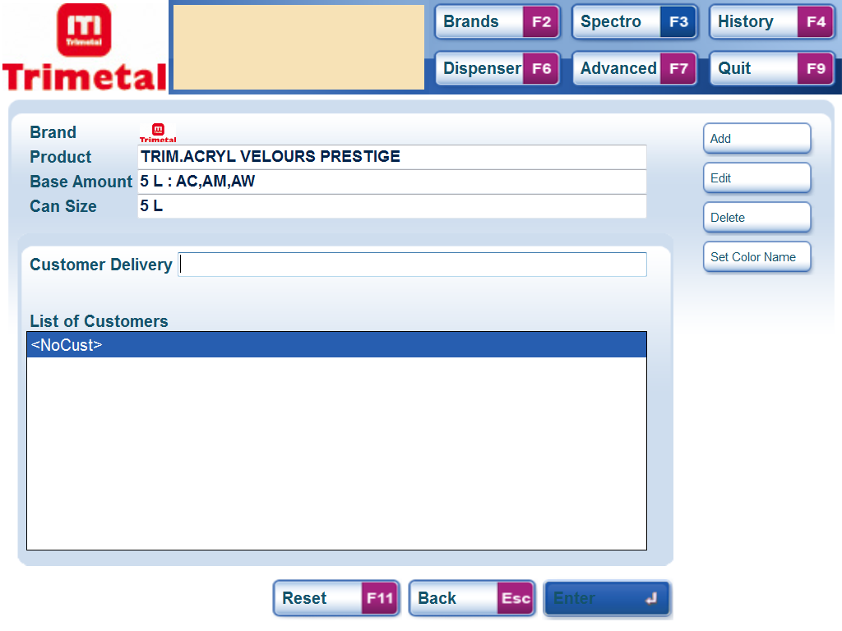
Colour Matching – Step 7
Add Customer
Customer List
If you want to save a customer name with the colour either select a customer from the list or add a new one by clicking add or pressing ALT1.

Slide 27
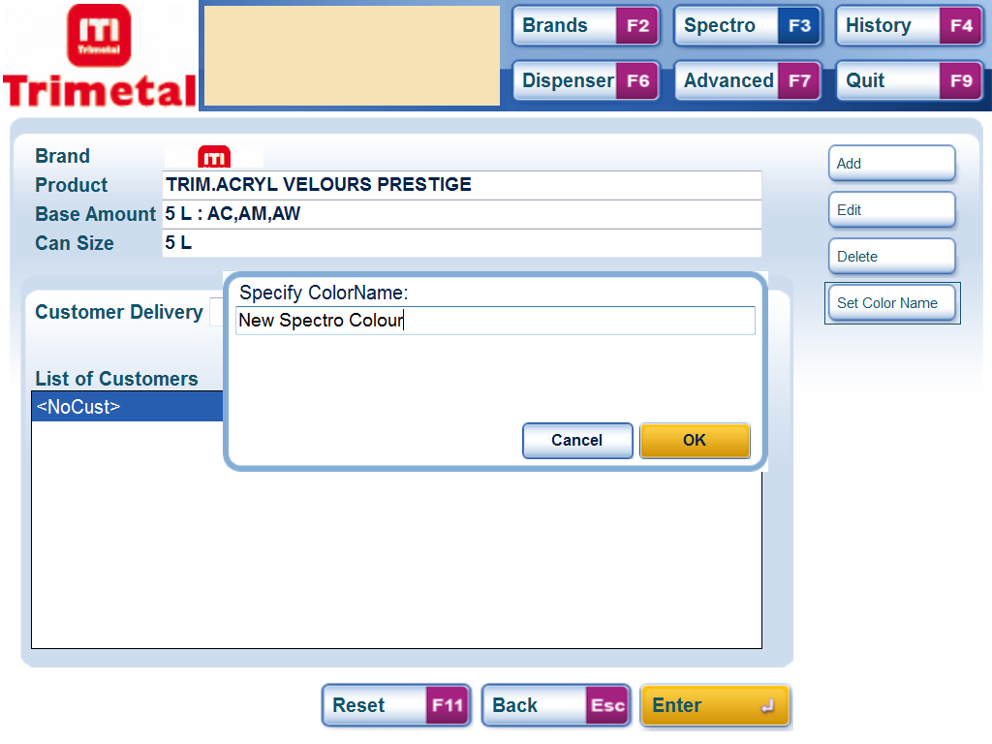
Colour Matching – Step 8
Set Colour Name
Enter New Name
Because this is a new colour it is also possible to define the name.
Click on Set colour Name or type ALT4 then type the name in the pop-up box and press OK to confirm.
Click or Press Enter to proceed.

Slide 28
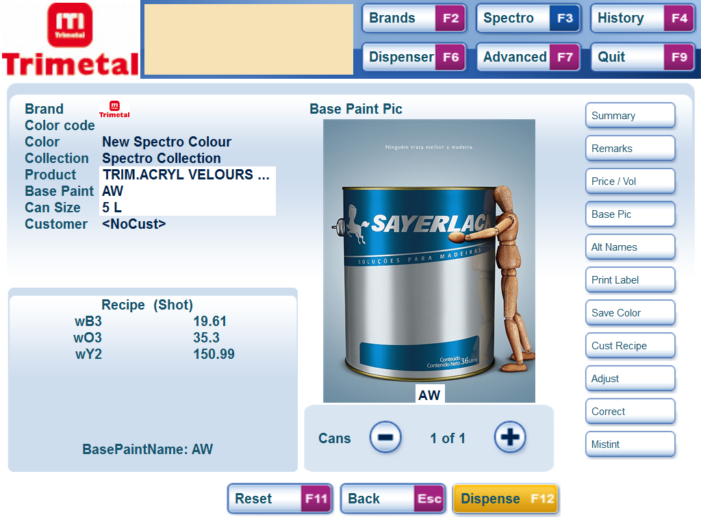
Colour Matching – Step 9
Details
Summary of Details
Formula
This screen shows a summary of the selections made. For other details click on the buttons on the right.
To Dispense click the Button or Press F12
To start again press F11 to return to the start screen.

