Slide 1

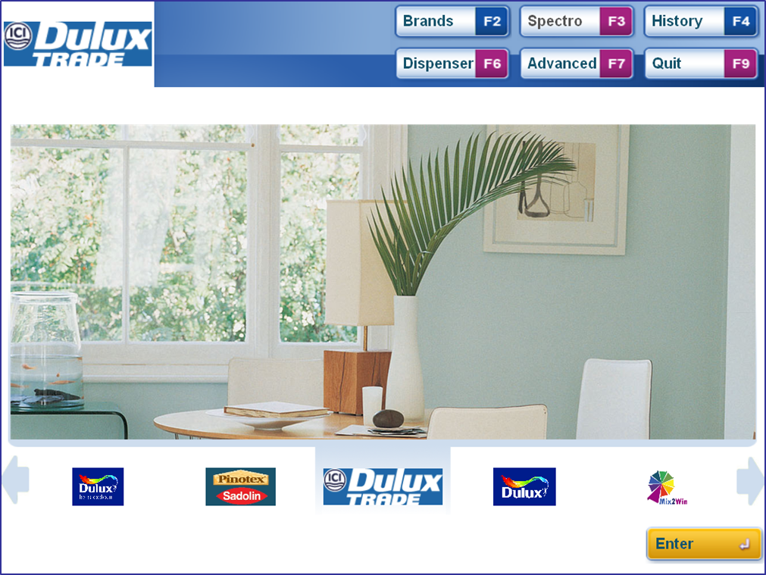

Welcome to Mix2Win User Manual Version 1.0.10
History
The History function allows you to find any colour previously mixed on the machine and mix exactly the same colour again.

Slide 2
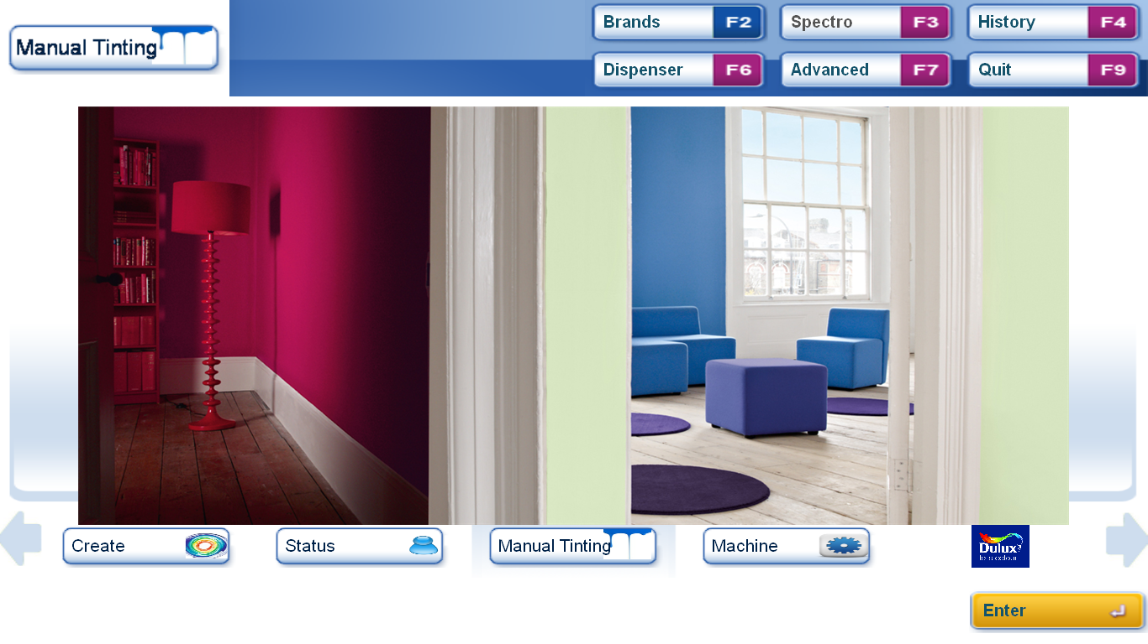
History – Step 1
History Button
From the start screen Click on History or Press F4

Slide 3
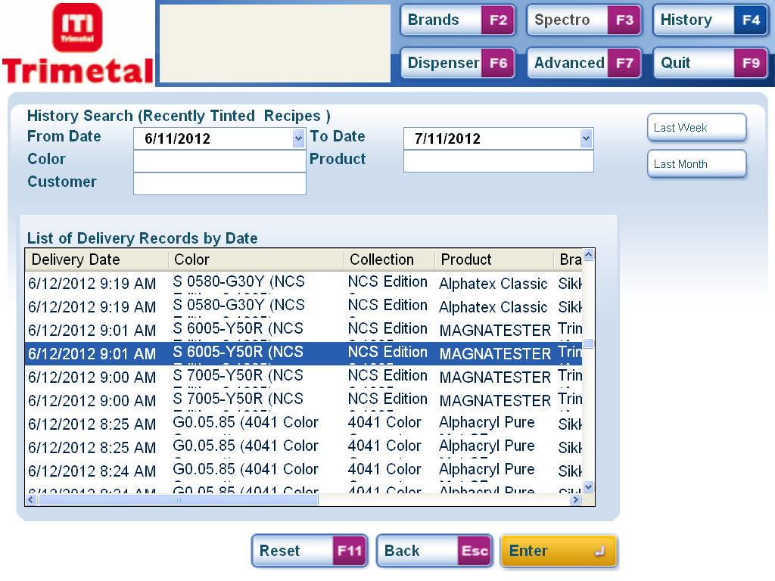
History – Step 2
Shortcuts
Search Options
Records List
The History Screen displays all the mixes made on this Dispenser.
A number of search items can be entered to refine the list. 2 Common shortcuts are also available at the press of a button to display mixes from the last week or last month,

Slide 4
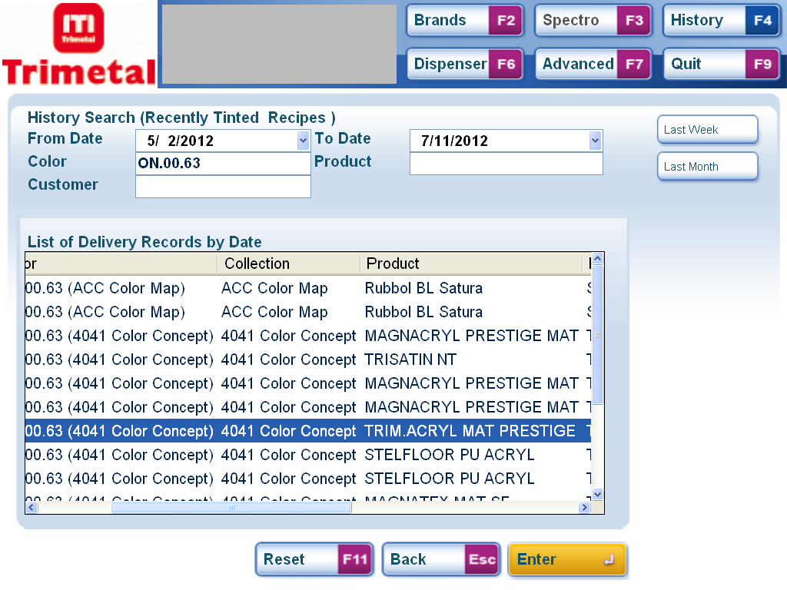
History – Step 3
Search using combinations of Options – in this example date and Colour Name
If necessary enter known search terms and press enter to refine the list.
Scroll through the list to find the desired record, remember that further information is shown off the right of the screen and press the right and left arrow keys to view.

Slide 5
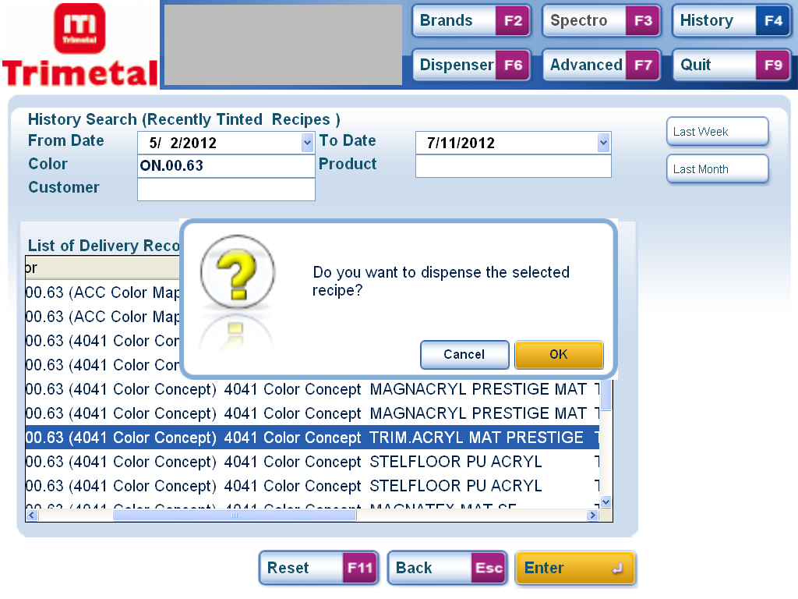
History – Step 4
Confirm Selection
When you have found the desired record press enter then press or click enter to confirm the selection in the pop-up box.

Slide 6
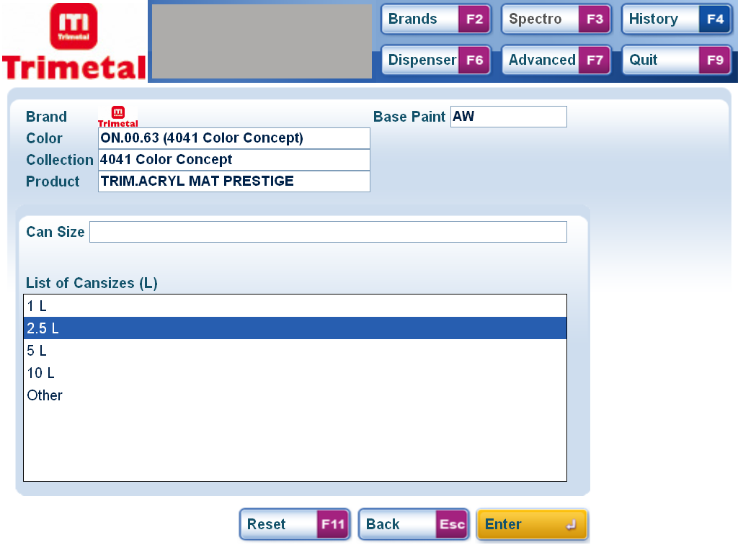
History – Step 5
Cansizes
Select the Cansize you want to mix the colour in and press or click enter to confirm.

Slide 7
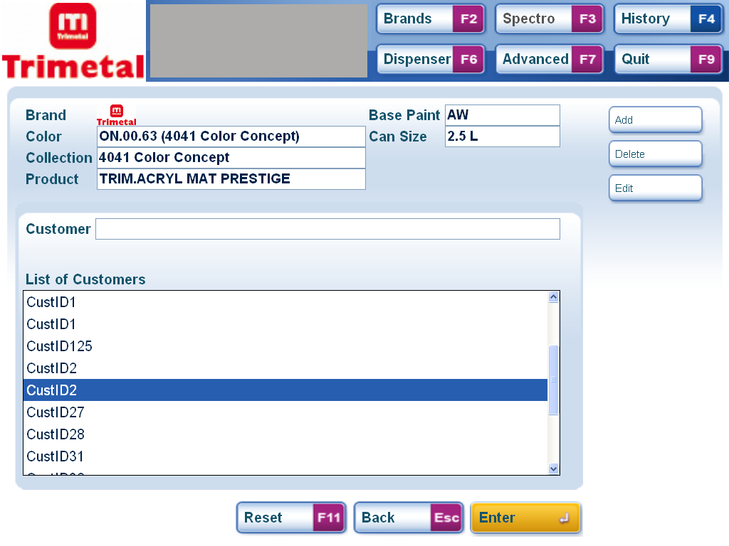
History – Step 6
Add Customer
Customer List
If you want to save the same customer name or a dfferent customer with the colour either select a customer from the list or add a new one by clicking add or pressing ALT1
To proceed Click or Press Enter.

Slide 8
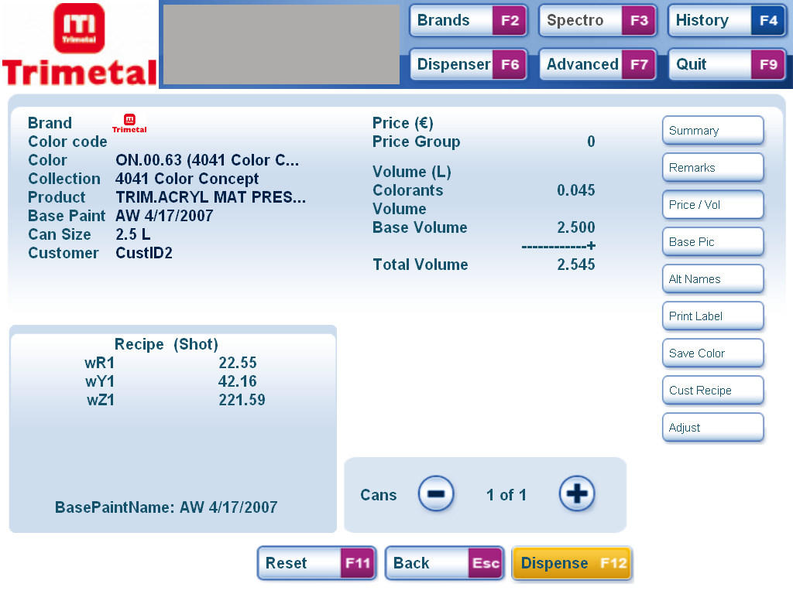
History – Step 7
Details
Summary of Details
Formula
This screen shows a summary of the selections made. For other details click on the buttons on the right.
To Dispense click the Button or Press F12
To start again press F11 to return to the start screen.

