Slide 1

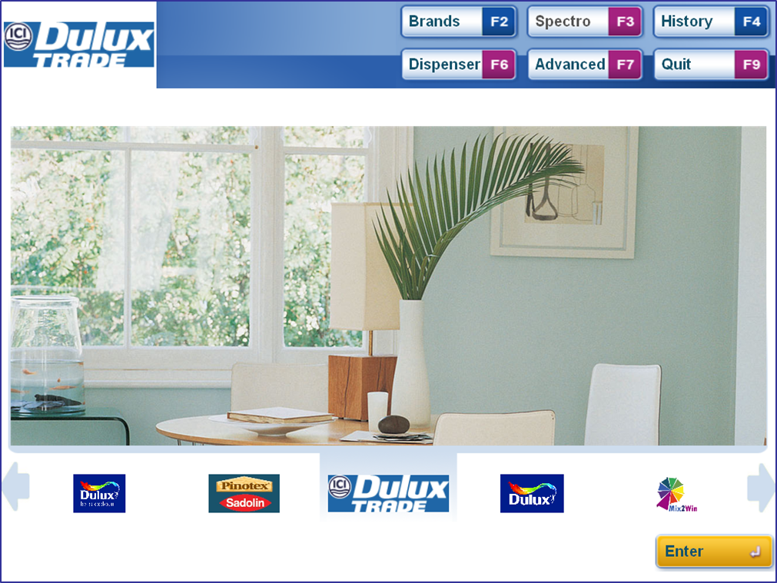

Welcome to Mix2Win User Manual Version 1.0.10
Dispenser Functions
The Dispenser functions allows you to manage and maintain the tinting machine to enable colour mixing to be carried out. successfully.

Slide 2
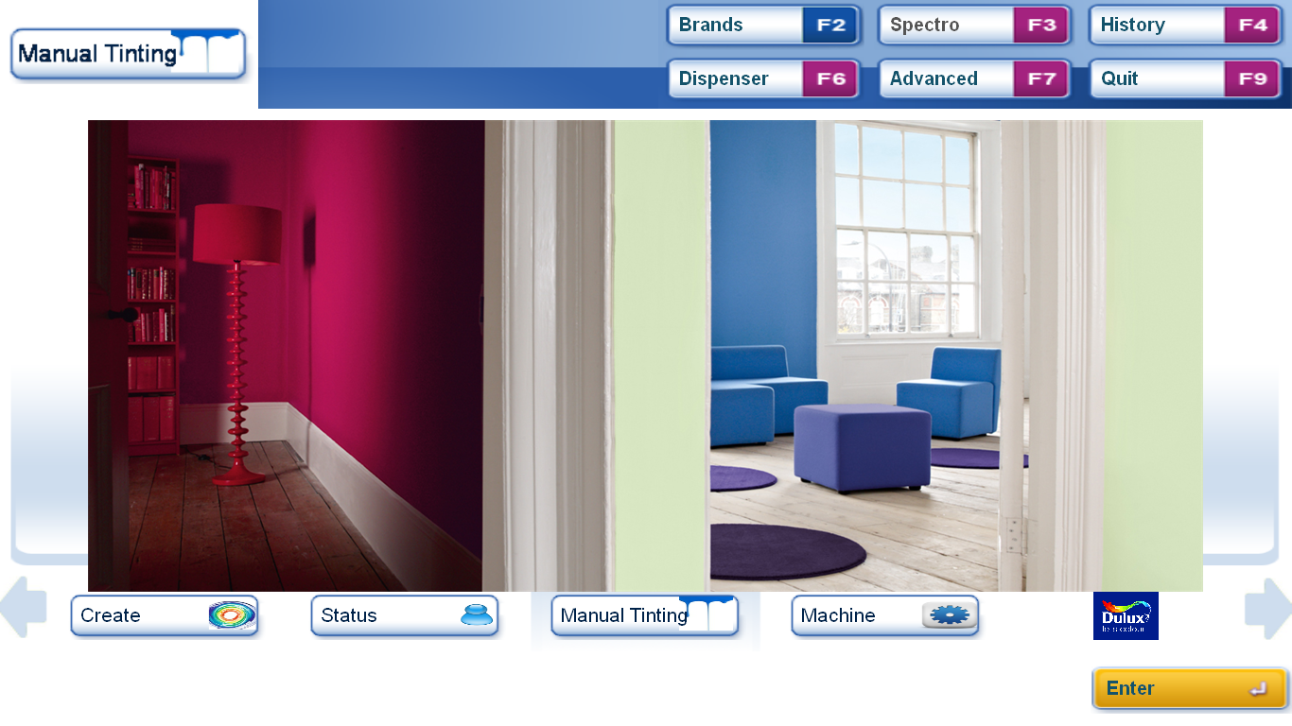
Dispenser – Step 1
Dispenser Button
From the start screen Click on Dispenser or Press F6

Slide 3
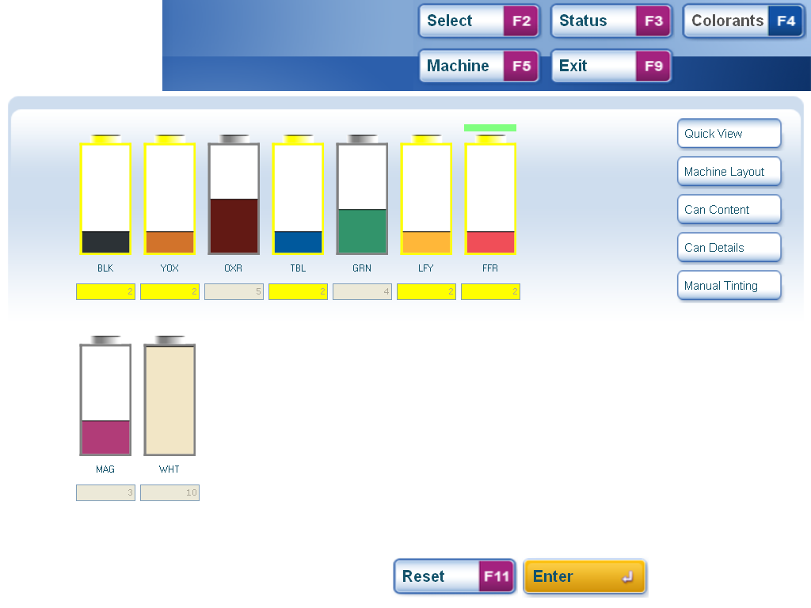
Dispenser – Step 2
Selection Buttons
Colorants
Ticapically the first screen shows an overview of the colorant levels, the other colorant screens can be accessed using the selection buttons on the right.
The number of colorants and canisters shown will depend on your tinting equipment and system

Slide 4
Dispenser – Step 3
Active Selection
ACTION required
The screen indicates colorants requiring attention in yellow and urgent attention is marked in red (not shown)
To refill a colorant double click on the canister or use the left and right keys to highlight the colorant as the active selection and press enter.

Slide 5
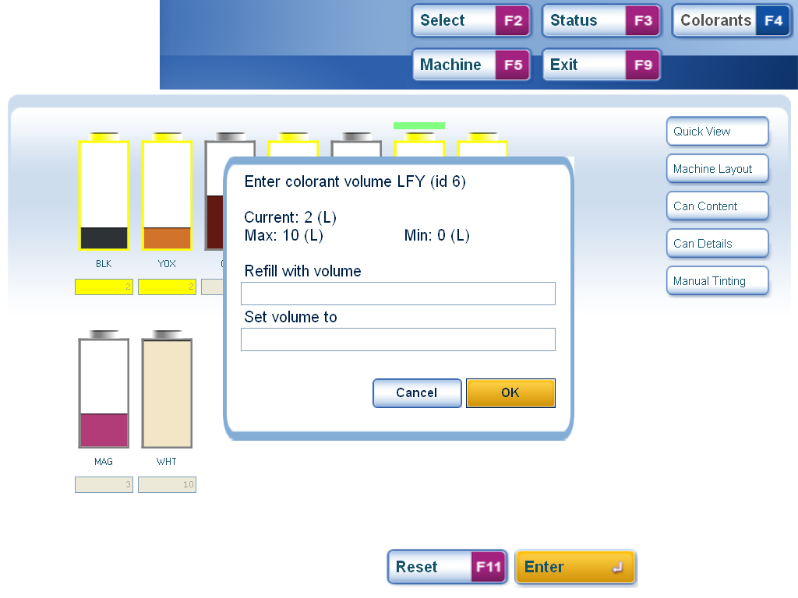
Dispenser – Step 4
Add Colorant
Adjust Colorant Level
To add colorant enter the volume you will add in the “refill with volume” section of the pop-up box.
To adjust the colorant level enter the new level in the “Set volume to” section of the pop-up box.
Press or click enter to confirm

Slide 6
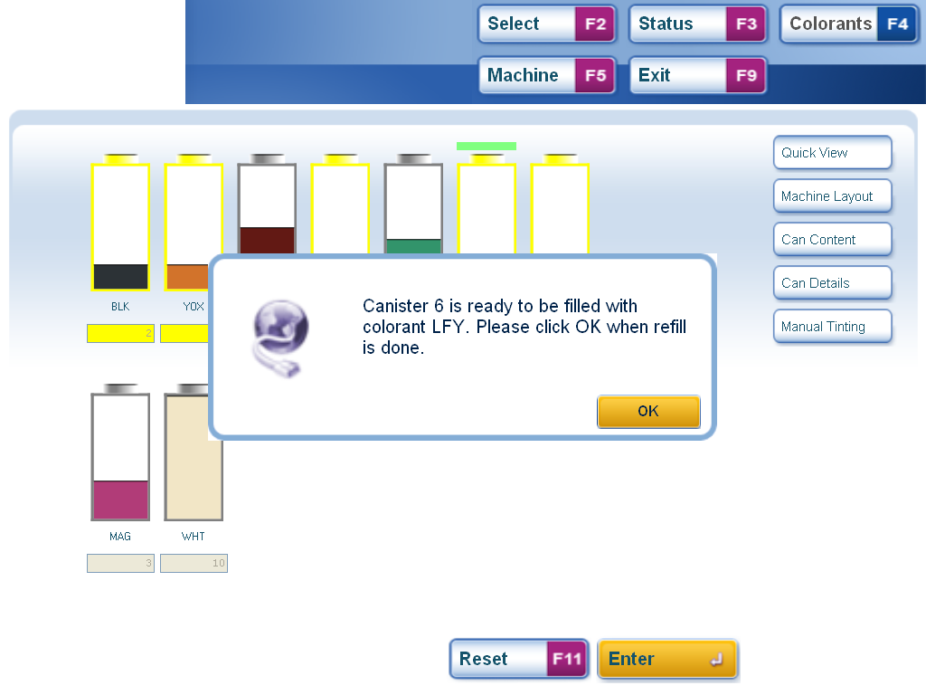
Dispenser – Step 5
Confirm message
The software will then confirm that the colorant can be added.
Note in some cases it is necessary to prepare the machine so it is important to wait for this message before proceeding.
Press or click enter to confirm the colorant has been added.

Slide 7
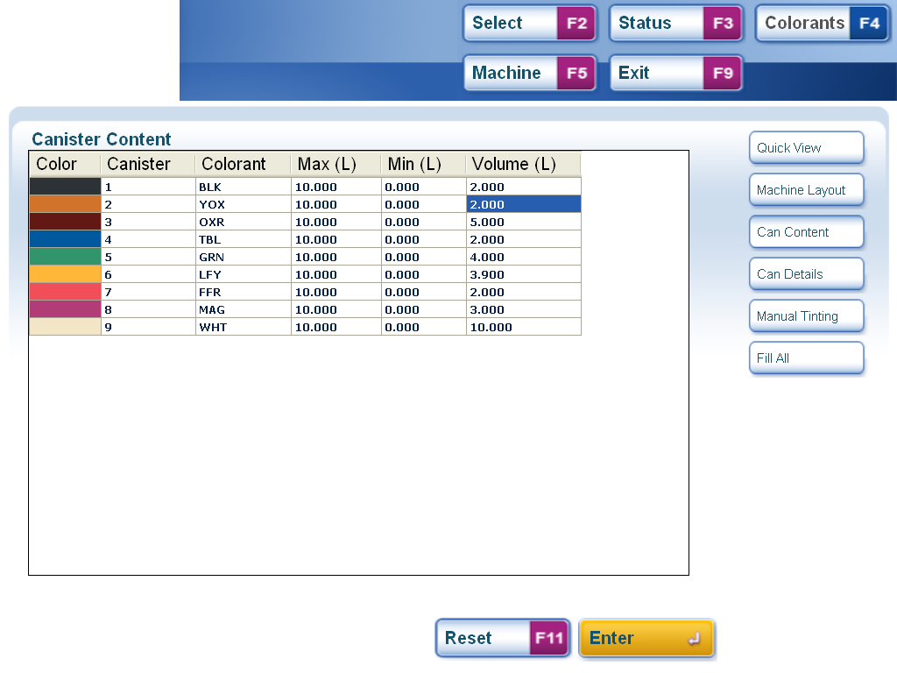
Dispenser – Step 6
Details
The Colorant Content screen can be accessed by pressing the appropriate button on the right or pressing ALT3
This gives a numeric overview of the colorant levels and canister volume.

Slide 8
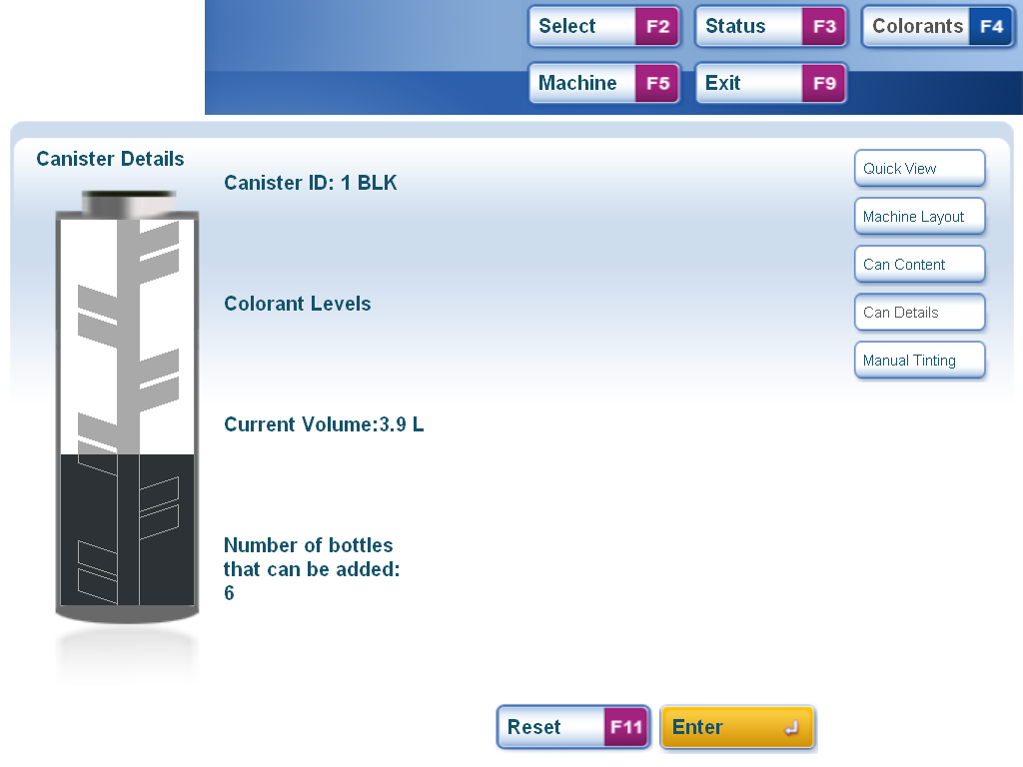
Dispenser – Step 7
Canister Graphic including stirrer
The Colorant Details screen can be accessed by pressing the appropriate button on the right or pressing ALT4
This gives a detailed overview of the colorant levels canister by canister including a graphic of the stirrer paddle to help judge the actual level.

Slide 9
Dispenser – Step 8
Canister Graphic including stirrer
To navigate between canisters use the left and right arrow keys. To adjust the colorant level on this screen use the “Page Up” and “Page Down” keys.
Changes can be made on any of the screens and are updated on all the others

Slide 10
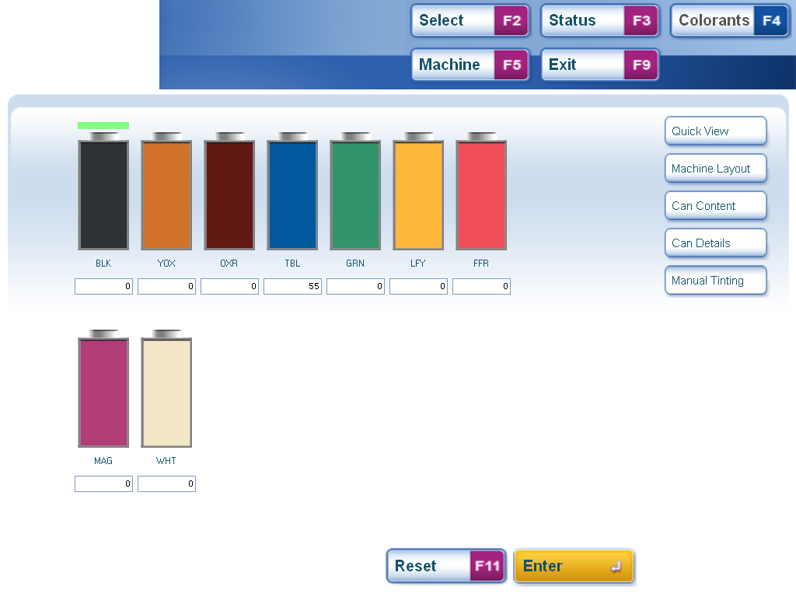
Dispenser – Step 8
Enter Formula here
The Manual Tinting screen can be accessed by pressing the appropriate button on the right or pressing ALT5
This allows the colorants to be dispensed directly by entering the formula in the boxes and pressing enter,

Slide 11
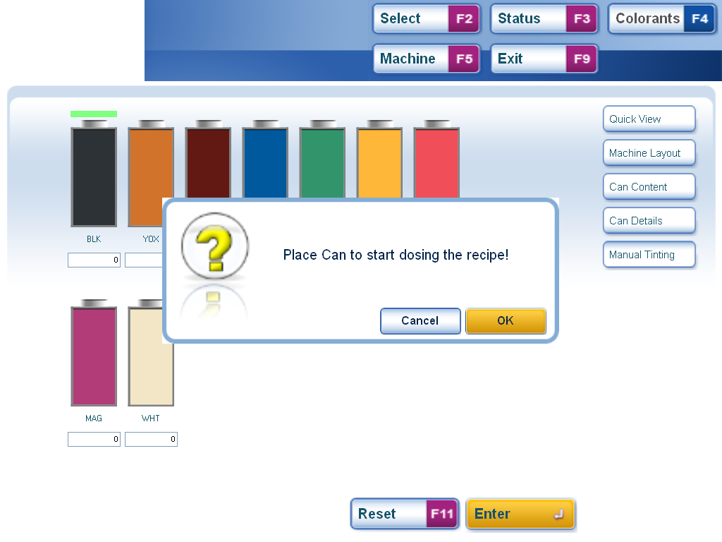
Dispenser – Step 9
Press enter to confirm and the machine will dispense the formula,
Note. This is a basic function that should not be used for mixing customer colours. Mixes are not recorded and labels normally not printed. Use Create Colour for special customer mixes.

Slide 12
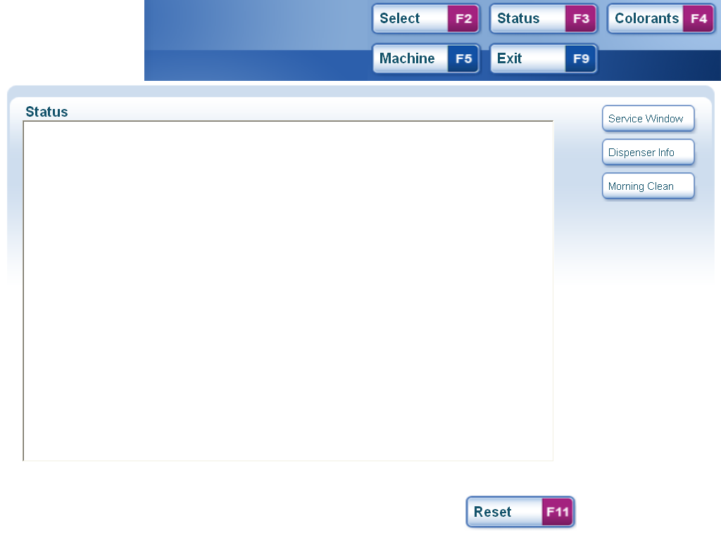
Dispenser – Step 10 Machine Functions
Machine Functions
Machine Information
The Machine screen can be accessed by pressing the Machine button or pressing F5 when in the Dispenser section of the software. A range of functions will be displayed on the right to manage the machine. Any feedback will be shown in the main window.
Press F9 to exit and return to the start screen.

