Slide 1

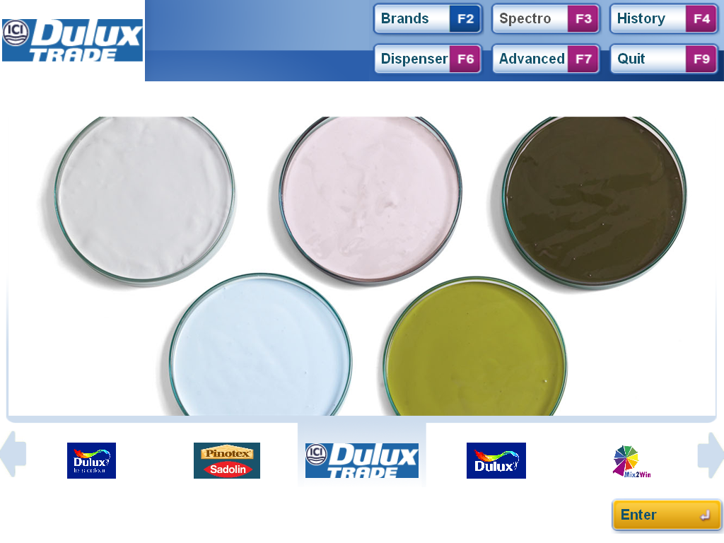

Welcome to Mix2Win User Manual Version 1.0.10
Save Customer Colours

Slide 2
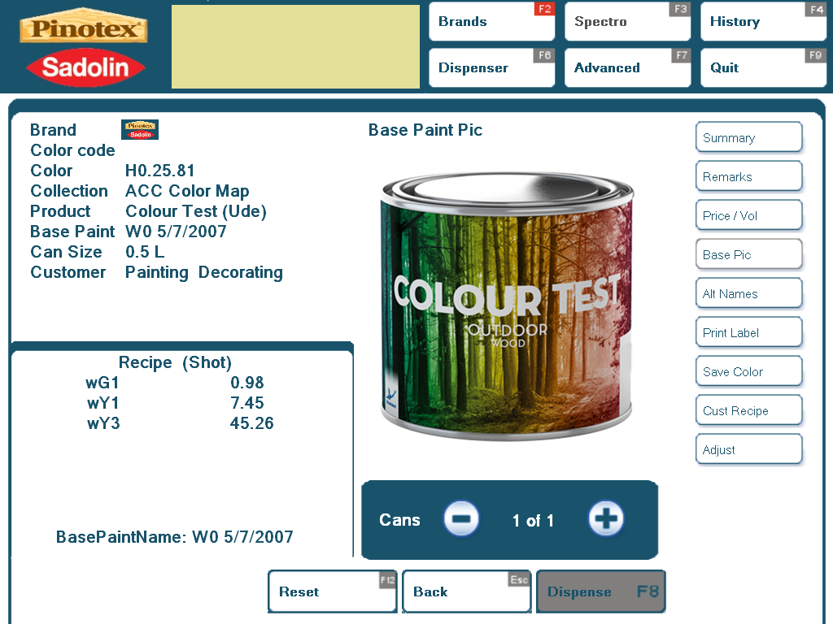
Save Colour Step 1 – Select Save Option
Save Colour
From the dispensing screen click on the Save Colour button or press ALT7

Slide 3
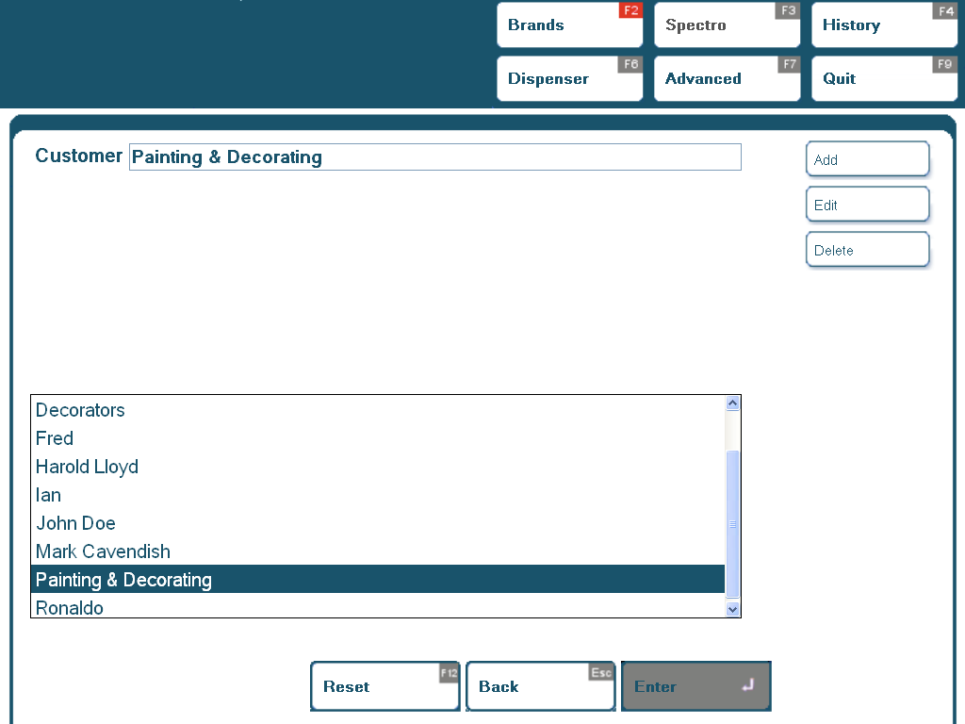
Save Colour Step 2 – Select Customer
Add New Customer
Selection Box
Use the Up and Down arrows to scroll though the list and select an existing customer entry by double clicking or pressing enter. Type in the selection box to refine the list if needed
For new customers Click on Add or press ALT1

Slide 4
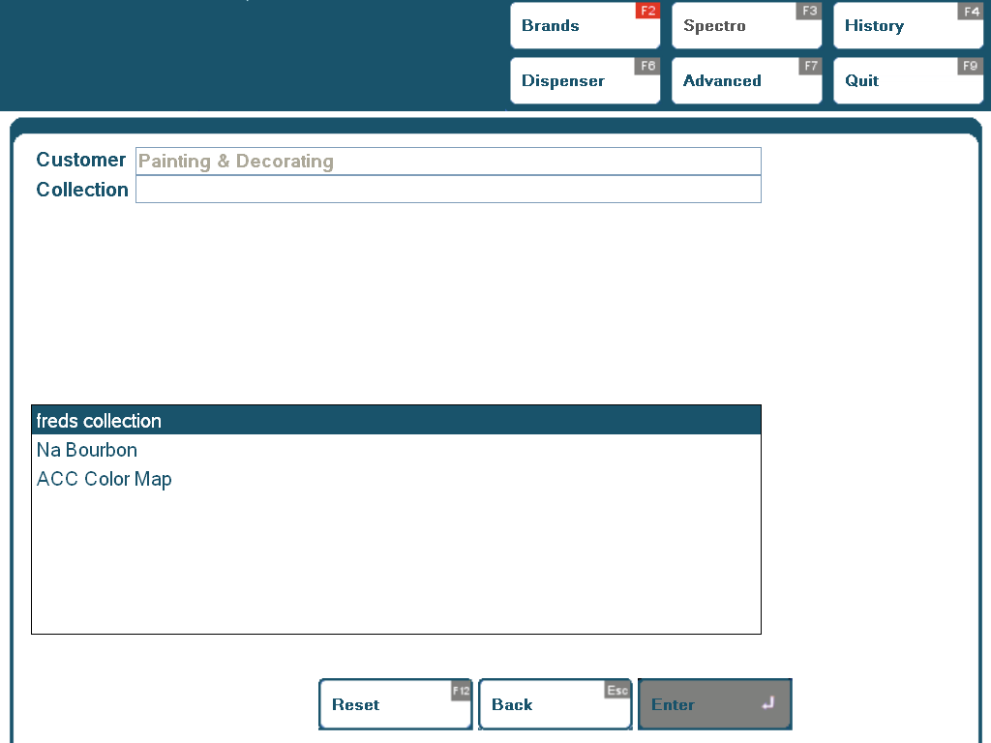
Save Colour Step 3 – Select Collection
List of current Collections
Use the Up and Down arrows to scroll though the list and select an existing Collection by double clicking or pressing enter.

Slide 5
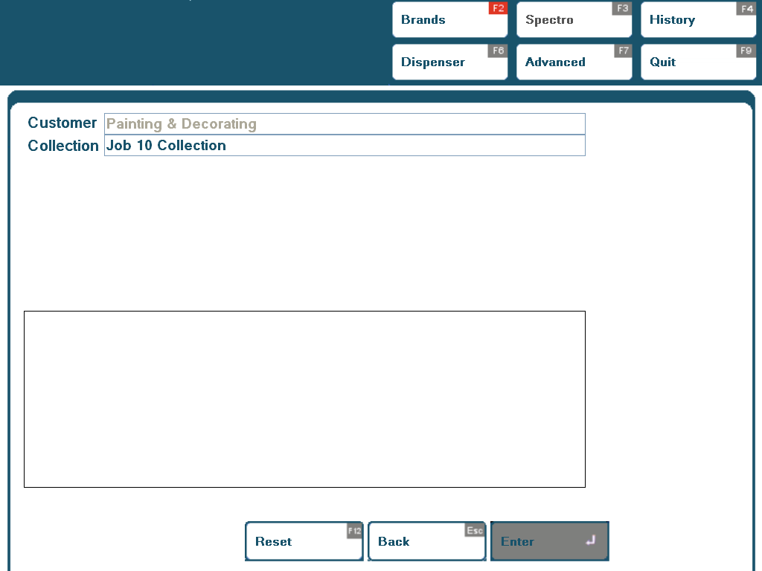
Save Colour Step 3 – New Collection
Collection Box – type new name here.
To add a new Collection name type the new name directly into the Collection Box
Press of Click Enter to continue.

Slide 6
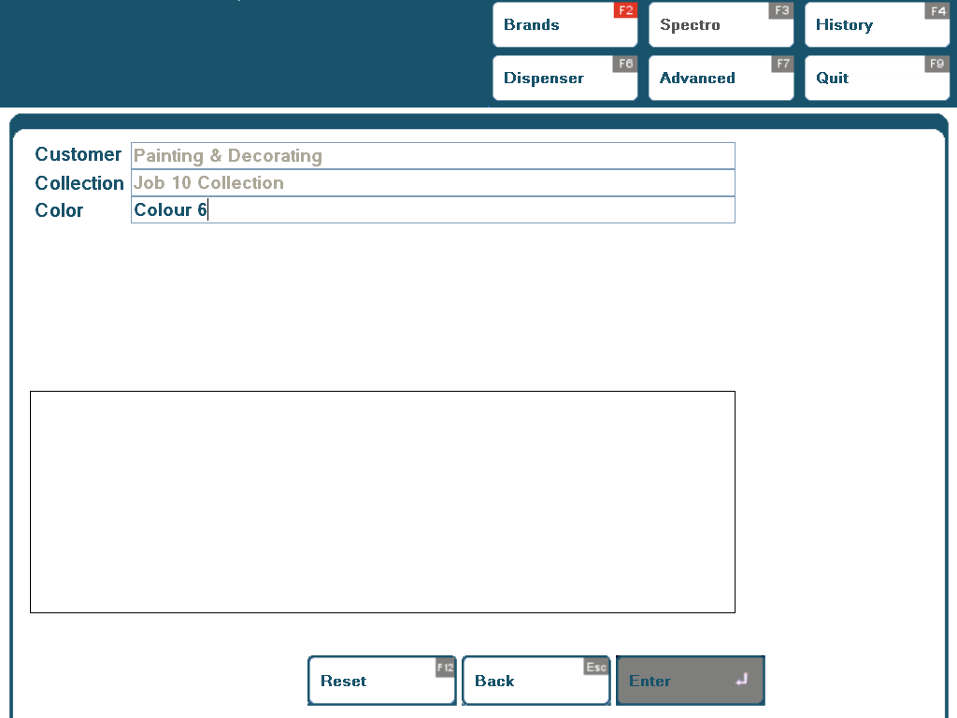
Save Colour Step 4 – Select Colour Name
Colour Box
Type new name here.
As with Collection select the Colour Name from the list of current options or to add a new Colour name type the new name directly into the Colour Box
Press of Click Enter to continue.

Slide 7
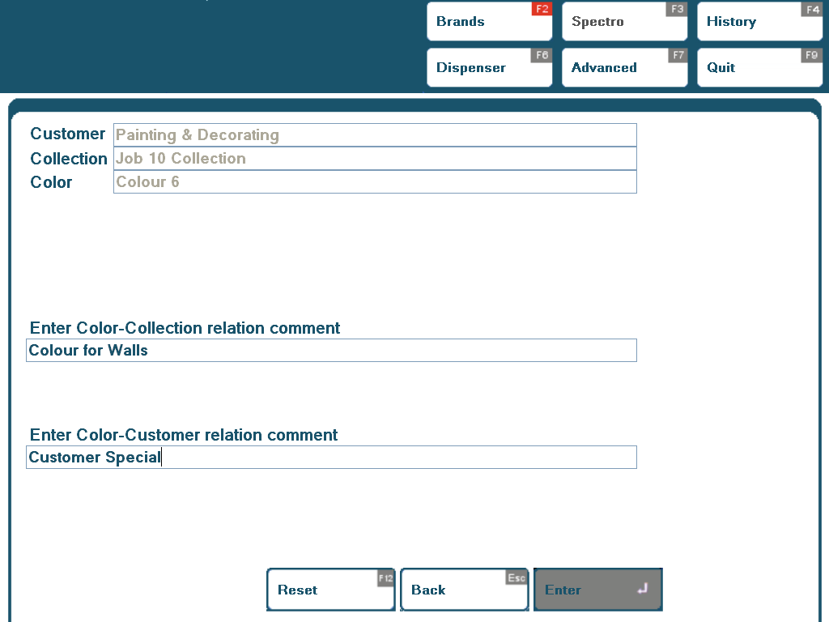
Save Colour Step 4 – Add Additional Details
Details
Add any comments to help identify the colour in the future.
Type any additional details in one or both of the comment boxes and then click or press enter to save the Customer record and return to the Dispense screen.

Slide 8
Welcome to Mix2Win User Manual Version 1.0.10
Retrieve Customer Colours

Slide 9
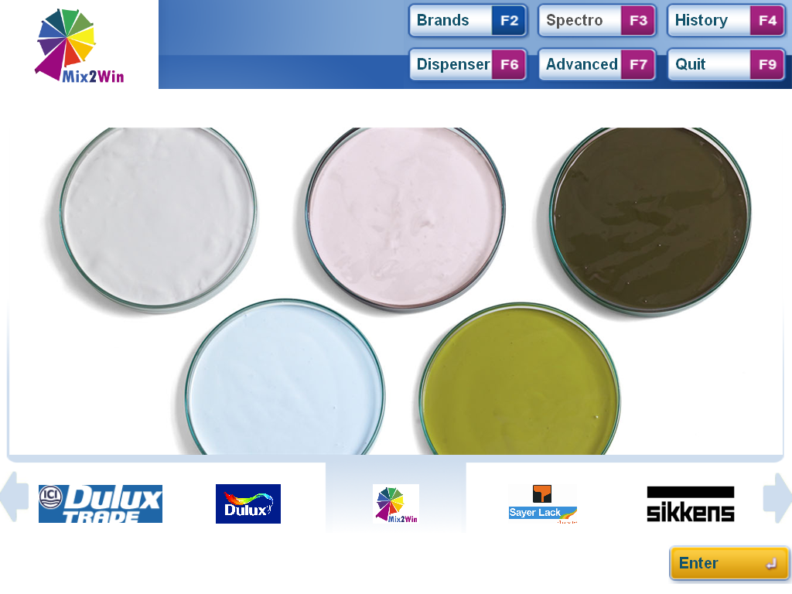
Retrieve Colour Step 1 – Select Saved Colours Database
Own Colour Icon
Also shown top left when selected.
Select the Saved Colours database by clicking on the icon or positioning the icon in the centre and pressing enter.

Slide 10
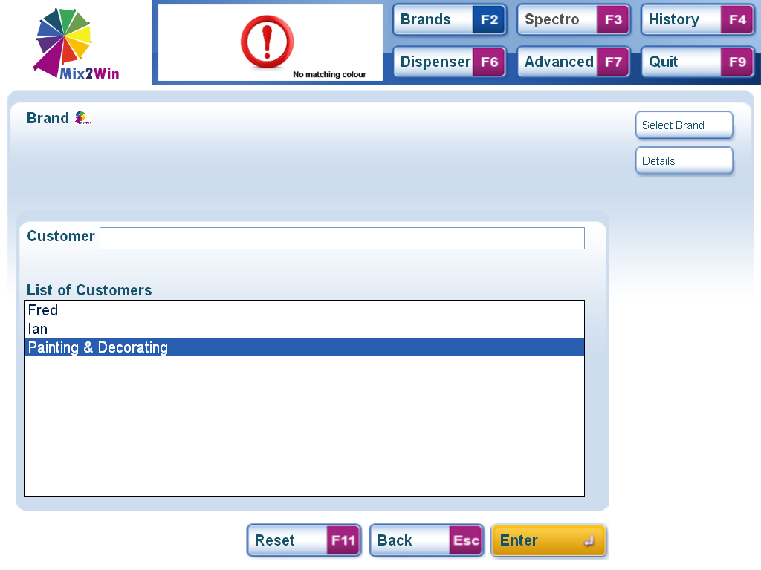
Retrieve Colour Step 2 – Select Customer
Details
Customer List
Select the Customer Name for the saved colour from the list.
For more information about a customer highlight the customer in the list and click on Details or press ALT2

Slide 11
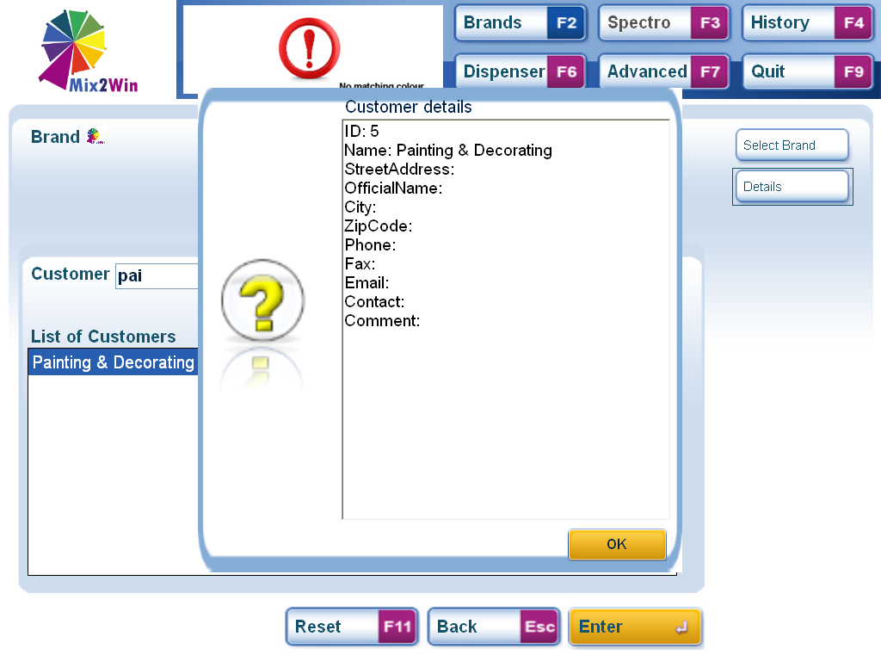
Retrieve Colour Step 2 – Select Customer (Details)
Customer Details Box
To help selecting the right Customer any details relating to the saved customer that were typed in are shown in the pop up box.
To return to the selection screen press enter or click the OK button.

Slide 12
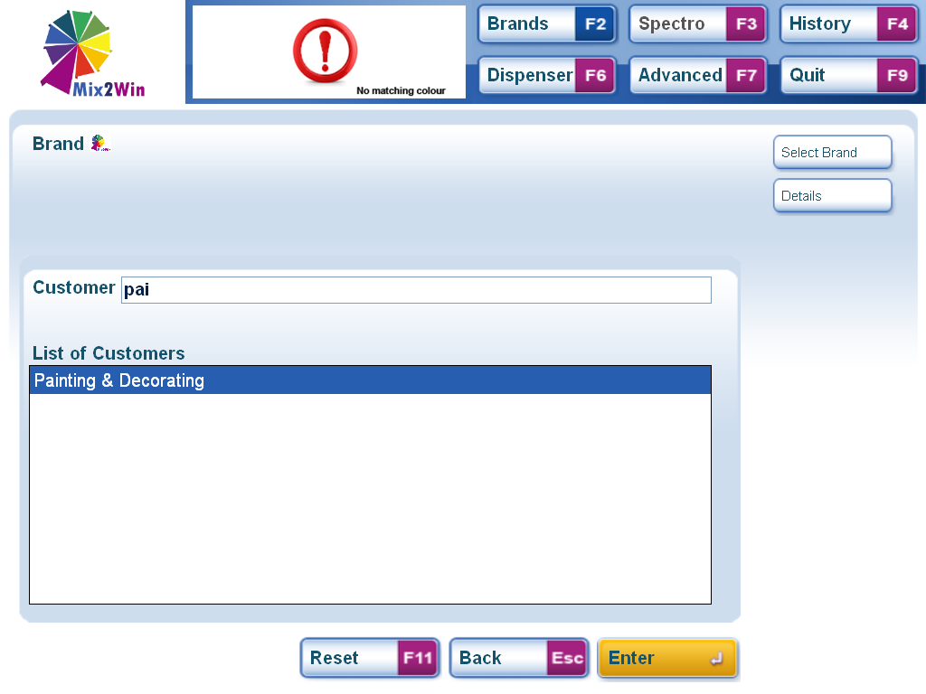
Retrieve Colour Step 2 – Select Customer
Selection Box
For long lists of customer names type in the selection box to refine the options in the list. Double click on the Customer Name or highlight and press Enter to select.

Slide 13
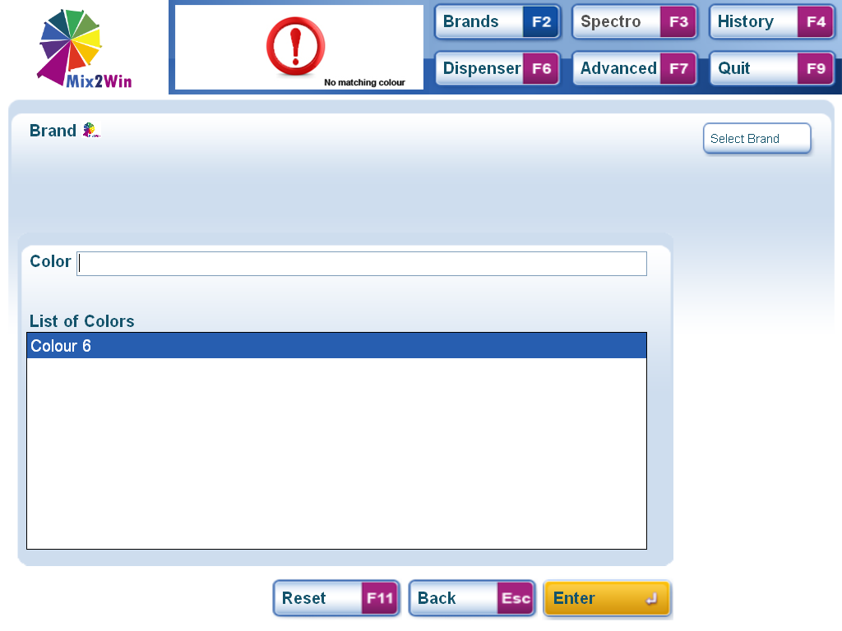
Retrieve Colour Step 3 – Select Colour Name
Selection Box
Select the Colour Name from the list.
For long lists type in the selection box to refine the list. Double Click or highlight and press Enter to select the Colour Name

Slide 14
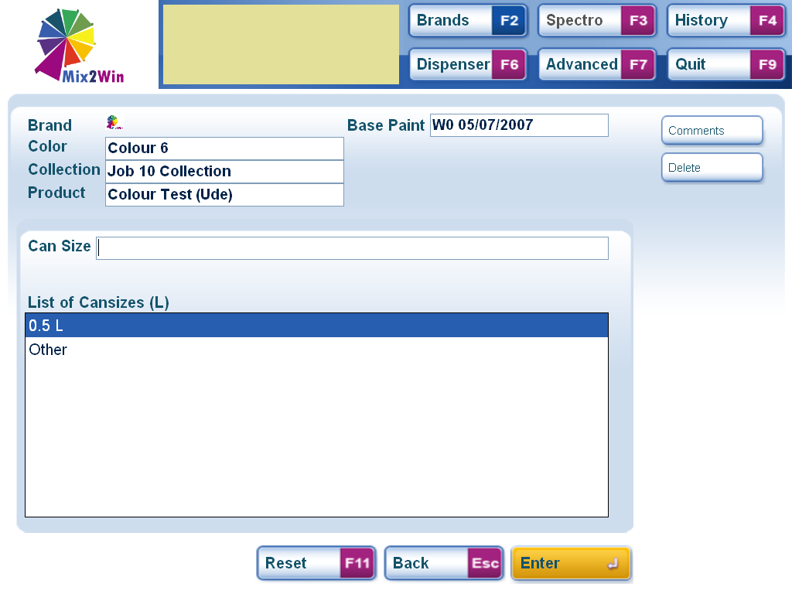
Retrieve Colour Step 4 – Select Can Size
Can Size Options
Select the Can Size from the list. For cans that aren’t shown select other and type the size you want.
Double Click or highlight and press Enter to select.

Slide 15
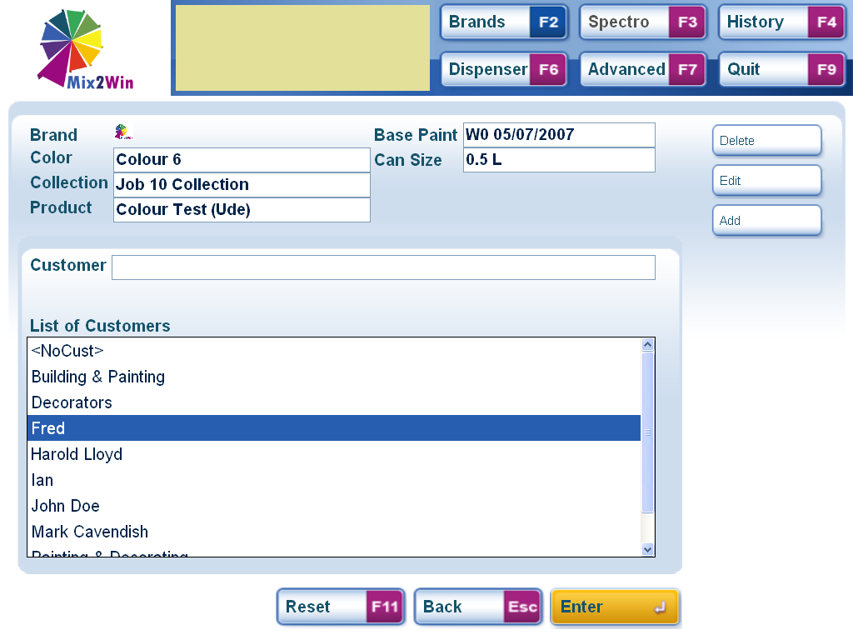
Retrieve Colour Step 4 – Select Customer
Add New Customer
Selection Box
Select the Customer from the list. For long lists type in the selection box to refine the list. For new customers click Add or press ALT3.
Double Click or highlight and press Enter to select.

Slide 16
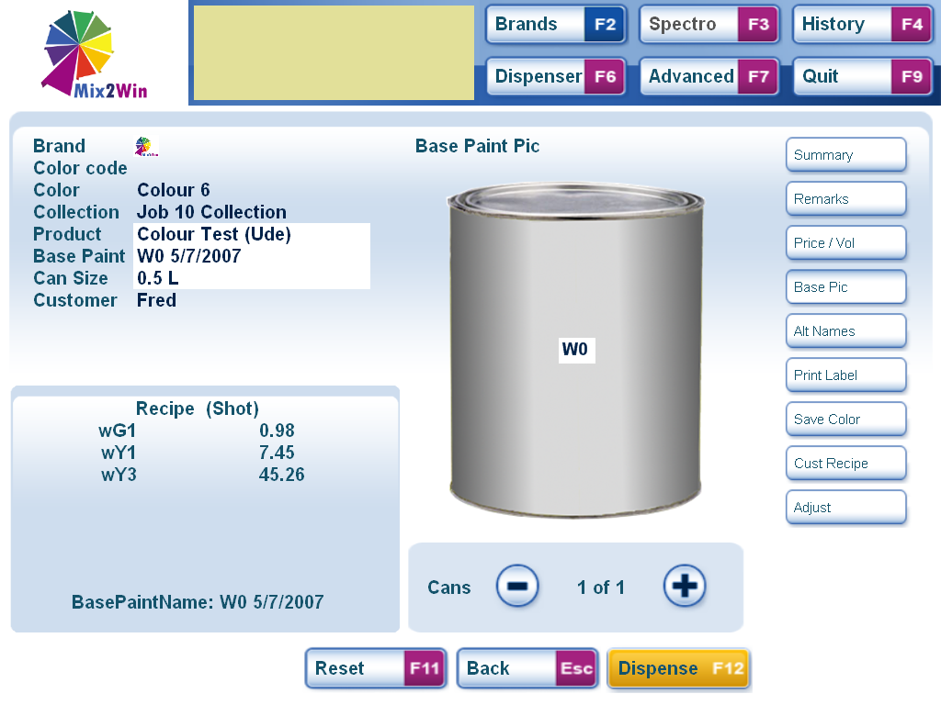
Retrieve Colour Step 4 – Dispense Screen
Remarks
Selection Details
Formula
All selections have now been made the details can be confirmed.
To check any specific details saved with this colour click on the Remarks button or press ALT2.

Slide 17
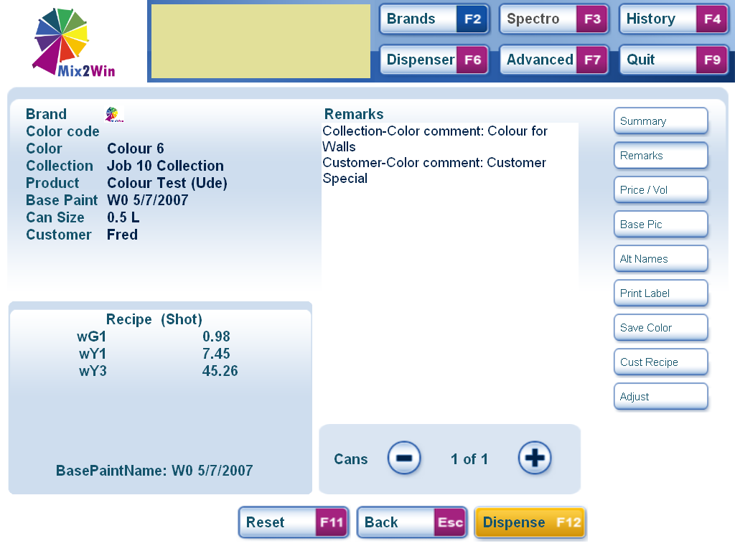
Retrieve Colour Step 4 – Details & Dispense
Saved Colour Details
DISPENSE
Any additional details that were saved are now displayed.
To dispense the colour Click Dispense or Press F12

