Slide 1

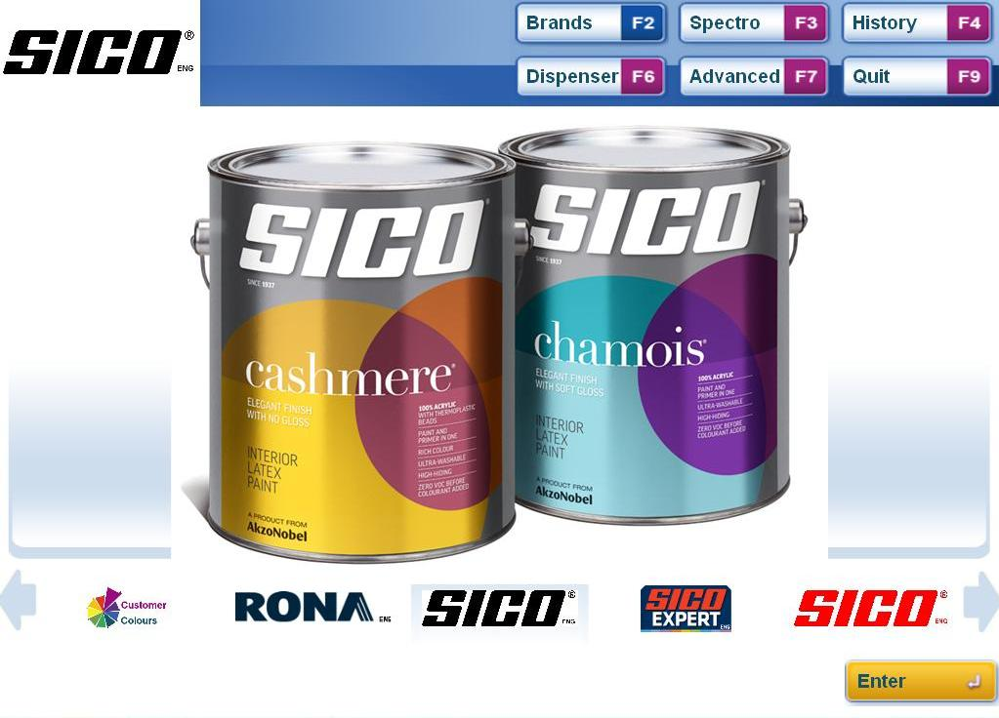

Welcome to Mix2Win User Manual Version 1.0.10
Create Colour

Slide 2
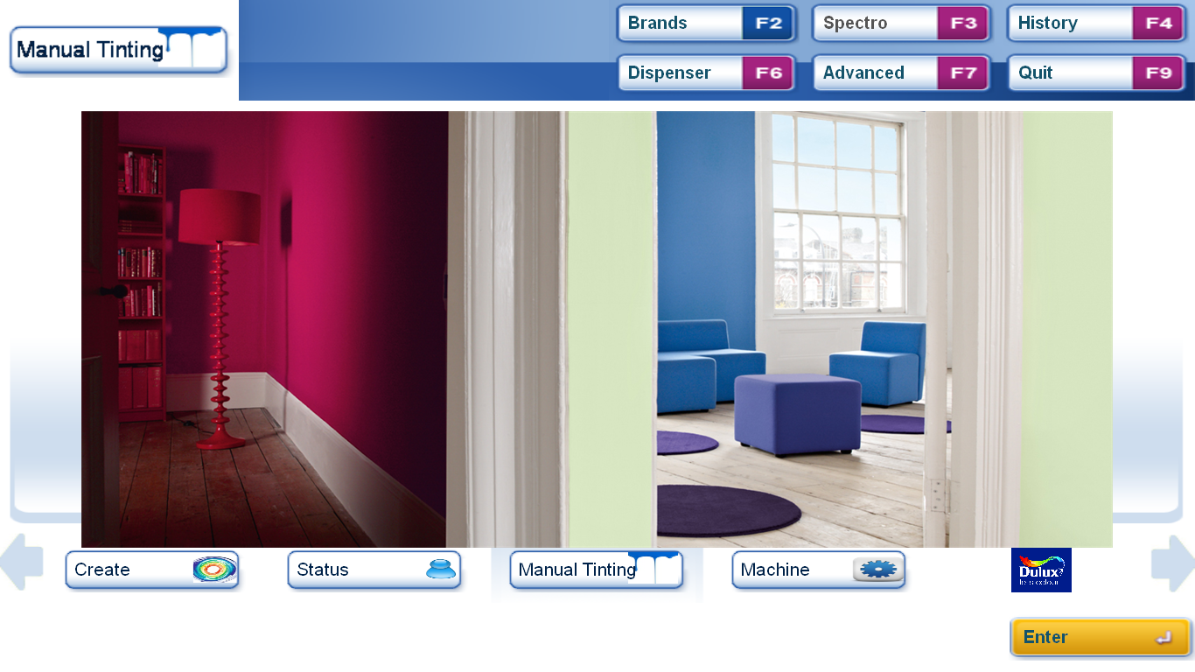
Create Colour – starting the function
Create Button
Click the reset button or press F11 to return to the start screen (as shown).
Use the left and right buttons to find the Create button and click or centre the button and press enter.
Alternatively press F7 (Advanced). then F3 (Create).

Slide 3
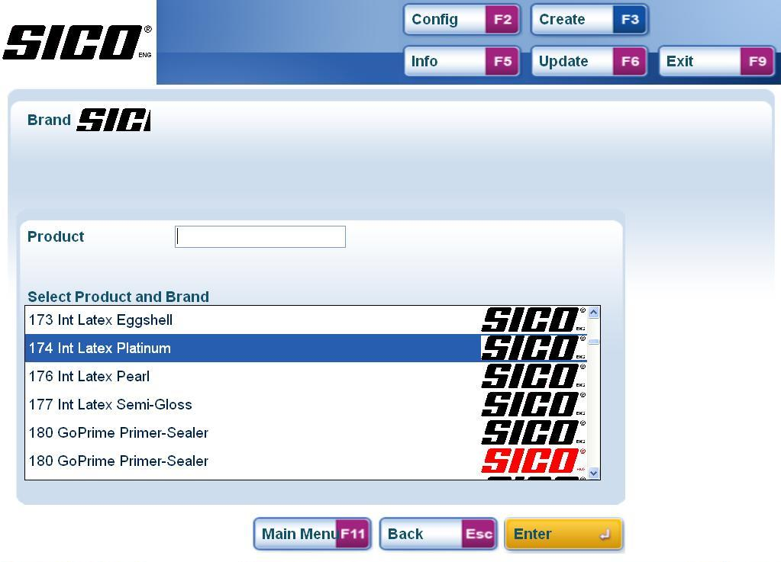
Create Colour Step 1 – Brand/Product Selection
Product and Brand Selection list.
This list is a display of all Brands and Products available on this installation
Use the up and down arrows to scroll through the list and double click on the desired product line or highlight the desired product line and click enter. Part or all of the product name can also be typed in the Product box to refine the list.

Slide 4
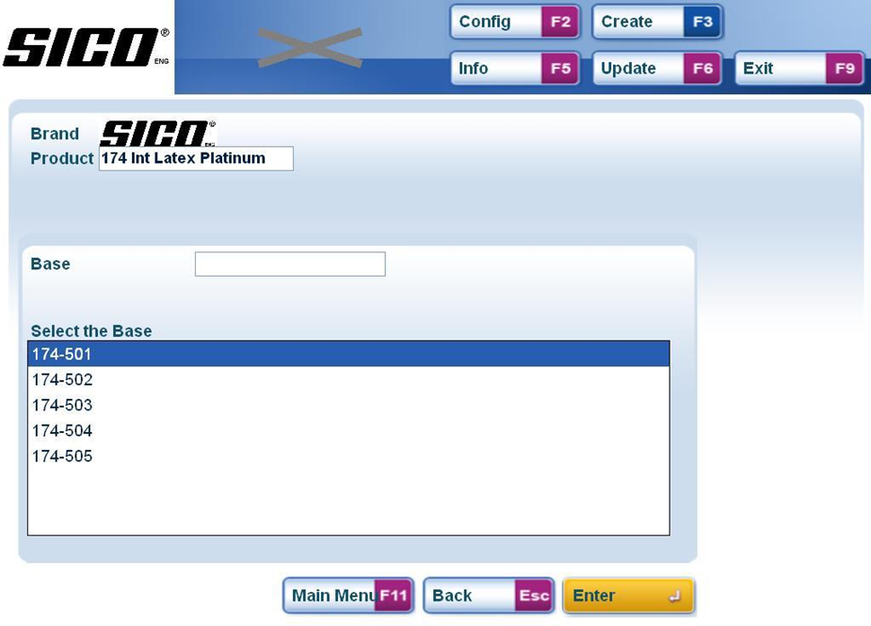
Create Colour Step 2 – Base Selection
Base Selection List
Select the base from the available options
Use the up and down arrows to scroll through the list and double click on the desired Base or highlight the desired Base and click enter. Part or all of the Base name can also be typed in the search box to refine the list.

Slide 5
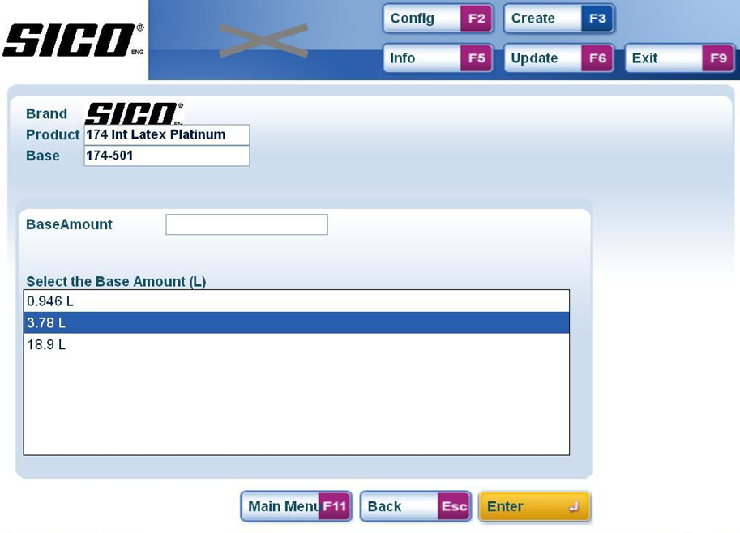
Create Colour Step 3 – Can Size Selection
Can Size Selection
Select the Can Size from the available options
Use the up and down arrows to scroll through the list and double click on the desired Can Size or highlight the desired Can Size and click enter. Note. This selection is for the Can Size of the formula not the Can Size to be dispensed, normally this is 1L

Slide 6
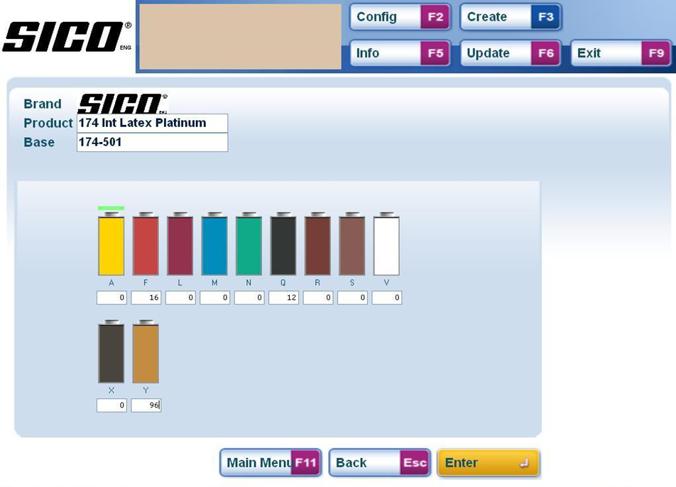
Create Colour Step 4 – Formula Entry
Colour Indication
The predicted colour will be shown here.
Formula Entry
Type the formula against each colorant
Tab or click between the colorant boxes and type in the quantity for the colorants in the formula.
Click or press enter to continue.

Slide 7
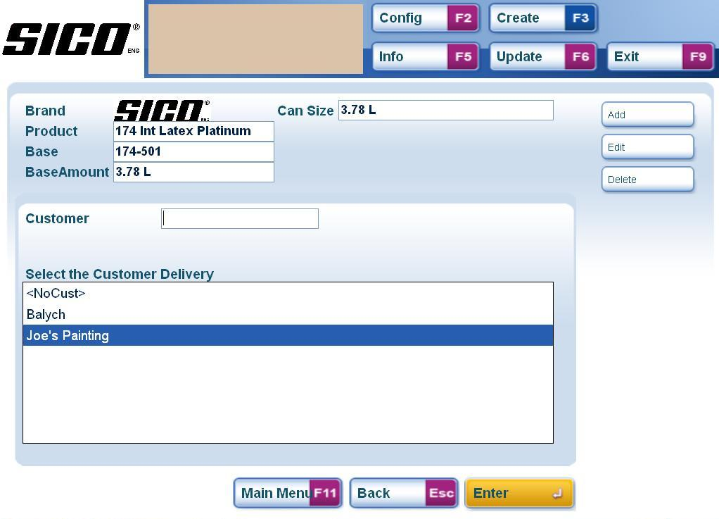
Create Colour Step 5 – Customer Selection
For new customers click Add or type ALT1
Customer Selection
Select from list
Use the up and down arrows to scroll through the list and double click on the desired Customer or highlight the desired Customer and click enter. Part or all of the Customer name can also be typed in the search box to refine the list.

Slide 8
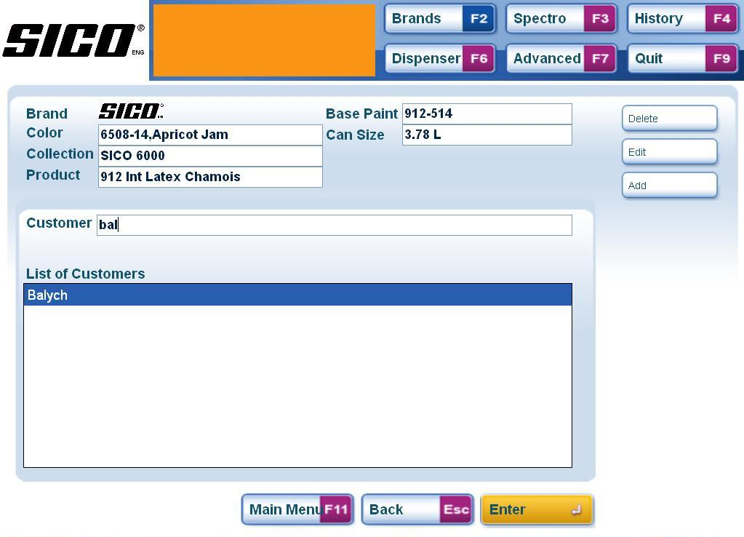
Brand Tinting Step 5 – Select Customer (long lists)
Enter your search criteria here
For long lists of customers enter search details to narrow down the list. Select the desired option and press enter to confirm.

Slide 9
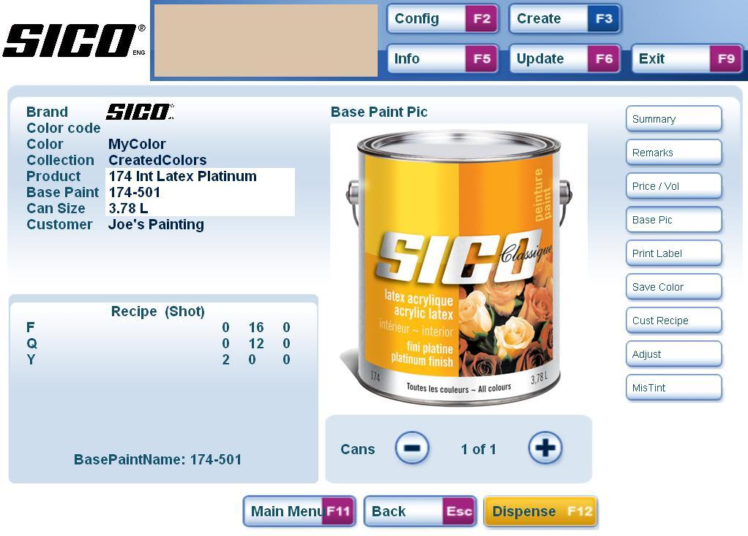
Brand Tinting – Summary Screen & Dispense
Picture of selected can
Summary of all items selected
Tinting Formula
DISPENSE
This screen summarises all the selections made.
When you have confirmed the details are correct press F12 or click the Dispense button to make this selection (automatic dispenser only)

